Slide 1
Level 3 Programming, adapting and delivering exercise for adults with long-term health conditions.
Programming and adapting

Slide 2
Session content
Planning considerations for delivering exercise sessions for adults with long-term health conditions.
How to assess and manage the risks in the exercise environment.
The effects of long-term health conditions on the body systems and implications for exercise.
Physical activity, ageing and disease processes and implications for exercise.
Safe and effective session structure and appropriate activities for specific long-term health conditions:
  warm-up
  cardiovascular training
  muscular fitness training
  cooldown
Benefits and limitations of different methods of monitoring exercise.
Modifications, adaptations and progressions.
The appropriateness of alternative types of activity.

Slide 3
Session focus – a to i
a. Cardiovascular
b. Respiratory
c. Obesity
d. Diabetes
f. Low back pain
e. Osteoporosis
h. Osteoarthritis, rheumatoid arthritis and joint replacement
g. Mental health
And i. multimorbidites

Slide 4
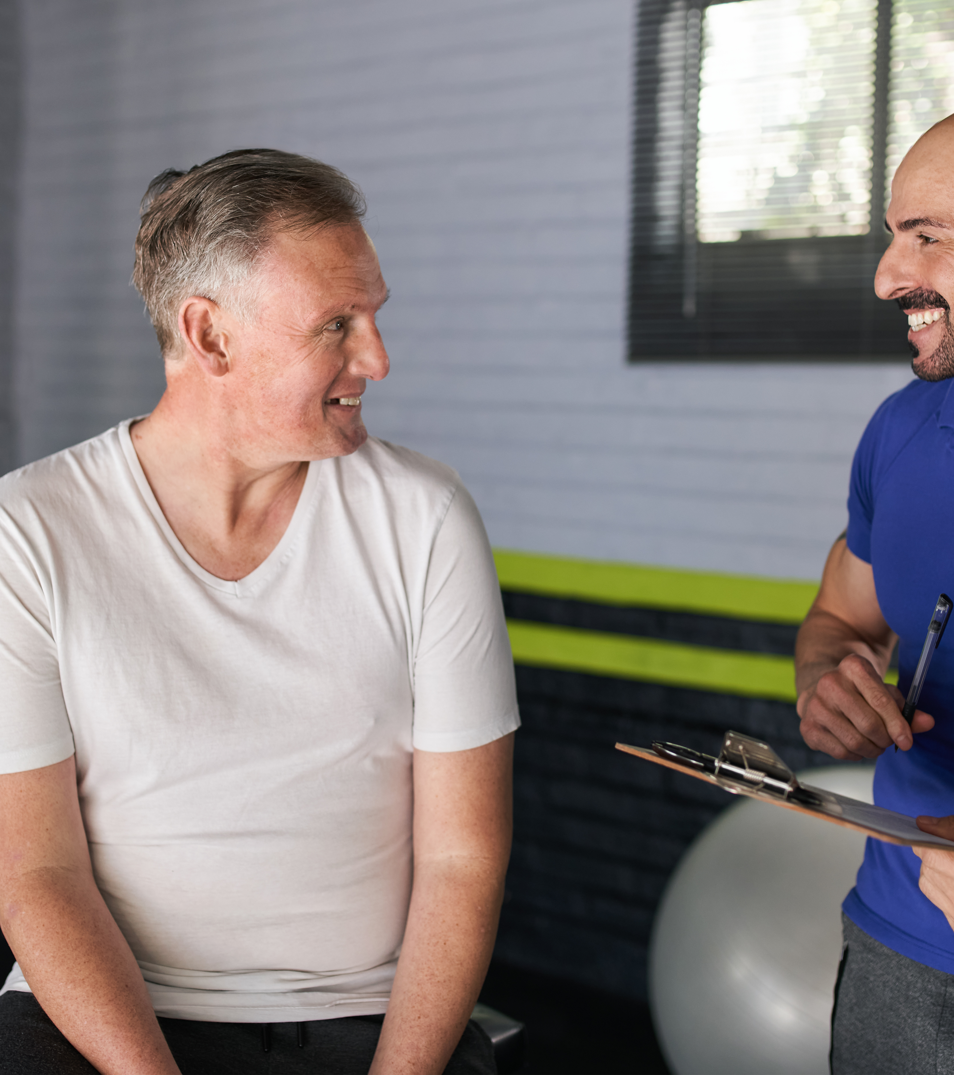
Planning considerations
Planning considerations for delivering exercise sessions for adults with long-term health conditions.
How to assess and manage the risks in the exercise environment.

Slide 5
Risk assessment
What incidents or potential risks could happen?
Who harmed?
Assess risk - likelihood and severity
Control measures – eliminate, reduce, isolate, control
Monitor and review
Activity: Planning considerations
What are some of the general checks required?
Environment
Equipment
Individual(s)
What additional checks may be needed for specific health conditions?

Slide 6
Risk management strategies
Eliminating - excluding those with contraindications or at higher risk or with conditions outside of scope.
Reducing - recommending a specific type of exercise session to suit certain needs and/or offering modifications.
Isolating - offering targeted sessions for a specific population, e.g. strength and balance sessions for those at risk of falls.
Controlling – examples:
Diabetes – ensuring they check blood sugar levels before exercise.
Asthma - bring medication with them.
Higher risk - increase the amount of supervision available.

Slide 7
Adaptations and modifications
Changing the exercise start position.
Reducing intensity variables such as resistance, repetitions, range of motion, and impact, and reducing the speed of exercises and movements.
Reducing overall session duration or changing the structure of a session, e.g. intermittent rather than continuous activity.
Giving more time for transitions between exercises, e.g. moving from standing to floor or even moving to different exercise start positions on an exercise mat.
Simplifying choreography (for dance-based classes).
Using alternative exercise modalities e.g., water-based rather than land-based activity, or equipment, e.g. a recumbent cycle will offer more back support than an upright cycle.
Offering support for balance, e.g. the use of walls or chairs etc.

Slide 8

Effects of long-term health conditions
The effects of long-term health conditions on the body systems and implications for exercise
Physical activity, ageing and disease processes and implications for exercise

Slide 9
Trio activity: Effects of long-term health conditions
Recap the effects of specific long-term health conditions covered in the role of physical activity for the LTC unit.
Identify specific risks to be managed.
Recap exercise guidelines and considerations for each condition (see next slide).
Consider:
  how to adapt session structure and content to accommodate these effects.
  methods to monitor intensity
  instructional skills.
Analyse the appropriateness of various genres.

Slide 10
Conditions – a to i
a. Cardiovascular
b. Respiratory
c. Obesity
d. Diabetes
f. Low back pain
e. Osteoporosis
h. Osteoarthritis, rheumatoid arthritis and joint replacement
g. Mental health
And i. multimorbidites

Slide 11
Overview of effects (including effects of ageing process)
Consider changes to the body systems relevant to specific health conditions (progressive and over time) including:
skeletal – e.g. bone density, joint mobility, range of motion (ROM), alignment and posture.
neuromuscular – e.g. posture, pelvic floor, power, strength, endurance, sarcopenia, heat production, immune function, fine motor control, coordination, balance and falls risk, reaction time (including the ability to respond to instructions), movement speed, sight and hearing, short-term memory.
cardiovascular – e.g. reduced anaerobic threshold, reduced exercise tolerance and ability to sustain activity.
respiratory – e.g. breathlessness.
cognitive – e.g. short-term memory.
psychosocial – e.g. low mood, low energy, loss of interest in life.

Slide 12
Inclusion criteria
Condition | Inclusion criteria
Hypertension | Stable and controlled*.
Hypercholesterolaemia and hyperlipidaemia | Stable and controlled*.
Hypothyroidism and hyperthyroidism | Stable and controlled*.
Coronary heart disease (CHD) | Post-phase IV rehabilitation only! No new referrals. CVD risk factors in moderate category. No myocardial infarction (MI).
Peripheral vascular disease (PVD) | Without other complications.
Diabetes type 1 and 2 | Stable and controlled with no complications * Health care professional (HCP) to advise on modification of insulin prior to exercise (if insulin dependent).
Obesity | Body Mass Index (BMI) 30 - <40*.
Chronic obstructive pulmonary disease (COPD) | Mild/moderate only*.
Asthma | Stable and well controlled.
Osteoarthritis | Level 1 and 2 only.
Rheumatoid arthritis | Early stage and moderate only. Not in flare up.
Osteopenia and osteoporosis | Early stage and moderate. No fracture history. No falls risk.
Low back pain | Non-specific only. No red flags. Yellow (psychological) flags may require signposting to pain management.
Joint replacement | Post-rehabilitation/physiotherapy.
Depression | Less severe (mild to moderate only).
General anxiety disorder (GAD) | Less severe (mild to moderate).

Slide 13

Session structure and content

Slide 14
Activity: Session structure and content
Warm up
Main component – CV and RT
Cooldown
What structural changes are required for the specific health condition?
How may the content in each component need to be modified?

Slide 15
General guidelines – structure
Warm-up – longer duration, more progressive and gradual increase of intensity, more targeted and isolated joint mobility for specific joints (e.g. where appropriate), lower intensity and impact, transitions and speed manageable.
Cardiovascular – lower impact, less intense, progressive and gradual build up and cooldown, interval approaches, during peak slower pace and less complex and less arm movements (if included) and less complex transitions.
Muscular – whole body approach, functional focus and related to daily activities, fracture site focus (e.g. osteoporosis), full range of motion and of sufficient intensity to be effective, avoidance of isometric exercises.
Cooldown and stretch – stretch positions appropriate, support and balance available (walls, chairs), use of aids to assist range of motion or comfort (pillows, cushions).

Slide 16
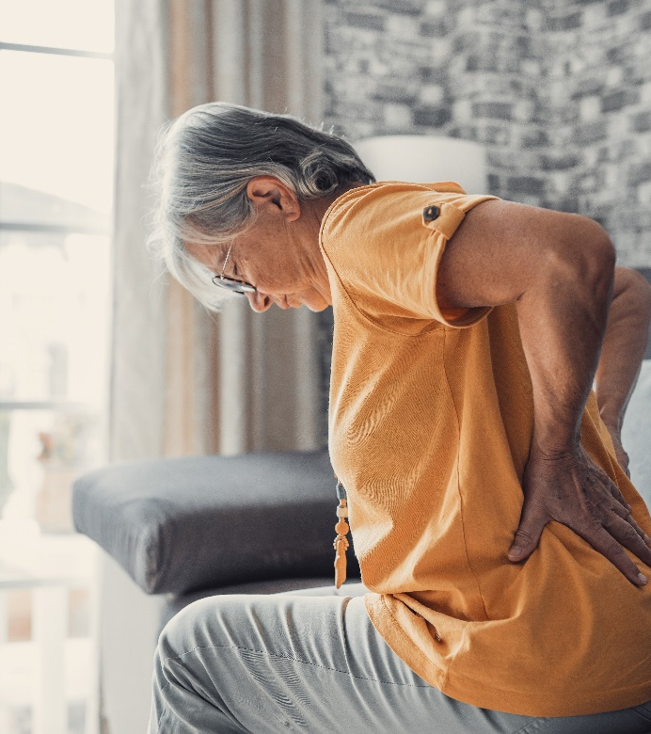
Modifications, adaptations and progressions

Slide 17

Activity: Adaptations, modifications and progressions
Independent activity:
Using a plan for a session you currently deliver as a template.
Outline some of the modifications and adaptations for specific exercises to accommodate the needs of specific long-term health conditions.
Consider how the session may progress over time.
Discuss with peers.

Slide 18
General adaptations
Frequency, intensity, time, and type
Intensity variables (modification/progression):
  range of motion
  repetitions
  resistance
  rate or speed of movement
  impact
  exercise positions and start positions
  weight-bearing
  balance and level of support
  music speed – appropriateness of speed and when not appropriate.

Slide 19
Condition grouping considerations
Adaptations will be needed according to specific conditions and levels of decline (as appropriate):
Joint impairments:
  Affected joints - shoulder, hip, spine, finger, toes, knees, wrist
  Effects - pain, reduced range of motion (ROM), stiffness, lack of strength, alignment and posture.
Cardiorespiratory – reduced tolerance and capacity, lower muscle mass, breathlessness.
Sensory impairment – visual, vestibular, hearing, proprioception.
Cognitive/mental – mild dementia, low mood, mild depression/anxiety, the decline in cognitive ability, short-term memory, decline in ability to follow instructions safely, decline in ability to sequence tasks.
How may these affect session content and structure?

Slide 20
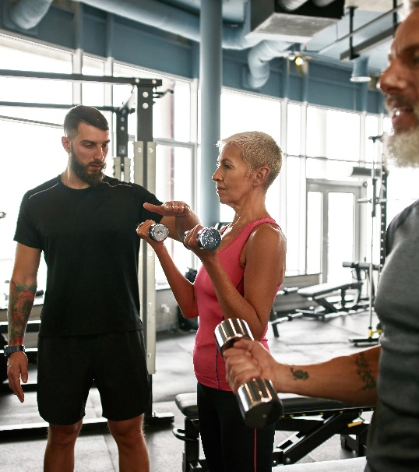
Monitoring safety and intensity

Slide 21
Observation
Noticing how people move into the environment.
Change of teaching position during a session – see and be seen.
Responding to observations
Teaching points – general and specific (individual).
Modifications and adaptations.
Monitoring exercise safety and intensity
Stages of observation include:
Noticing and seeing nuances with movement, posture, technique, gait etc.
Recognising how this affects the person, e.g. what they can or cannot do.
Using the information - tailoring of exercises
Responding and adapting to specific needs during a session.
Experience and reflective practice support the development of these skills.

Slide 22
Monitoring intensity – perceived exertion
Classification of intensity | RPE 6-20 scale | CR10 0-10 scale | Corresponding % heart rate max
Very light | <9 | 1 | <57%
Light | 9-11 | 2 | 57-63%
Moderate | 12-13 | 3-5 | 64-76%
Vigorous | 14-17 | 6-8 | 77-95%
Near maximal | >18 | 9 | >96%
(ACSM, 2022)

Slide 23
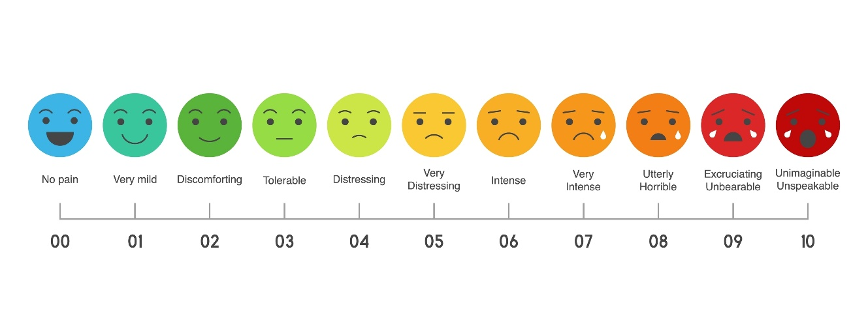
Pain scales
When may these be used?

Slide 24
Modified Borg dyspnoea scale
0 | Nothing at all
0.5 | Just noticeable – very, very slight
1 | Very slight
2 | Slight breathlessness
3 | Moderate | Exercise training zone
4 | Somewhat severe
5 | Severe breathlessness
6
7 | Very severe
8
9 | Almost maximal – very, very severe
10 | Maximal
(Lung Foundation Australia, 2020), (ACSM, 2022)

Slide 25
Questions
Tell me how this exercise feels for you.
Tell me what this exercise feels like.
What other questions?

Slide 26

Alternative types of physical activity and exercise

Slide 27
Activity
Circuit training
Exercise in water
Fitness walking
Group indoor cycling
Yoga
Pilates
Gym-based exercise
Group exercise to music
Freestyle or pre-choreographed
Qigong and Tai Chi
Pair or trio task:
What are the advantages or benefits and disadvantages or limitations of the listed exercise modalities when working with specific long-term health conditions.
Consider the ‘RISK’ element – which may present lower risk and why?

Slide 28
Environment
Equipment used
Instruction style
Session structure and design style – mainstream or tailored for specific LTCs
Exercise selection and choice
  Exercise start positions
  Transitions
  Impact
  Intensity
  Rate
  Range of motion
  Resistance
Music selection (if used) BPM
Things to consider regarding genres
All of these may affect the appropriateness of the genre for individuals with LTCs.

Slide 29
Pair task
What are two main take away points from this lesson?
How will you apply these when programming and delivering for clients with long term health conditions?

Slide 30
Summary
Planning considerations for delivering exercise sessions for adults with long-term health conditions.
How to assess and manage the risks in the exercise environment.
The effects of long-term health conditions on the body systems and implications for exercise.
Physical activity, ageing and disease processes and implications for exercise.
Safe and effective session structure and appropriate activities for specific long-term health conditions:
  warm-up
  cardiovascular training
  muscular fitness training
  cooldown
Benefits and limitations of different methods of monitoring exercise.
Modifications, adaptations and progressions.
The appropriateness of alternative types of activity.

Slide 31
Level 3 Programming, adapting and delivering exercise for adults with long-term health conditions.
Programming and adapting

