Slide 1
Level 3 Programming, adapting and delivering exercise for adults with long-term health conditions.
Behaviour change models

Slide 2
Lesson content
Three lessons
The main principles of behaviour change models and theories:
Session A - Transtheoretical model
Session B – COM-B and Health belief model
Session C – overview of:
  Person-centred approaches – core conditions
  Biopsychosocial model
  Self-determination theory.

Slide 3
Transtheoretical model
Session A

Slide 4
Lesson content
The main principles of the transtheoretical model (TTM).
Effective motivational strategies and techniques that can be used to support participants to adhere to physical activity and support lifestyle behaviour(s) change.

Slide 5

Transtheoretical model
Share your thoughts and ideas:
What do you currently know about the TTM Model?

Slide 6
Stages of change
Processes of change
Self-efficacy
Various motivational tools can be used
Main components

Slide 7
Stages of change
Contemplation
Maintenance
Action
Preparation
Pre-contemplation
Relapse
Termination
The cycle ends
Consider individual readiness to make a change at each stage?

Slide 8
Processes of change
Consciousness raising
Self-liberation
Social liberation
Counter conditioning
Stimulus control
Self-re-evaluation
Environmental re-evaluation
Contingency/ reinforcement management
Dramatic relief
Helping relationships
Pair research task:
Find examples for each process

Slide 9

Self-efficacy
Efficacy expectations - perceived confidence about their ability, not the same as their actual ability!
Outcome expectations - do they see possible actions as making a difference to their current circumstances.

Slide 10
Self-efficacy – Bandura
An individual’s perception of their ability is a key factor determining their motivation:
to initiate a change (intention) – get started
to expend effort whilst making a change (volition) – commit to something e.g. attend an exercise session
to keep going and sustain the change (adherence) – keep doing it!

Slide 11
Key sources that inform self-efficacy
Self-efficacy
Own experiences
Experiences of others (role-modelling)
Verbal persuasion
Physiological and affective states

Slide 12
Key sources that inform self-efficacy
Own experiences: Past success builds efficacy, and past failure can reduce efficacy, especially if attached with experiencing uncomfortable emotions/affective states.
Experiences of others (role-modelling): Seeing others, like self succeeding or failing.
Verbal persuasion: Being influenced by others, especially when their opinion is respected and valued.
Physiological and affective states: How psychological and physiological effects are responded to and managed.
Can you think of some examples of these?

Slide 13
Not thinking about making a change.
Does not see any reason or need to make changes.
Have little awareness of the consequences of their chosen behaviour.
Do not see any problem with behaviour or choose to ignore this (denial).
Not ready!
Precontemplation
Pair task:
What motivational strategies may you use?

Slide 14

Thinking about making a change.
Weighing up reasons for and against
Change talk and sustain talk (motivational interviewing).
High ambivalence.
Could be ready.
Contemplation
Pair task:
What motivational strategies may build change talk?

Slide 15
Decisional balance
What are the benefits of making a change?
What are the benefits of staying the same?
What are the disadvantages of making a change?
What are the disadvantages of staying the same?

Slide 16
Likert scales
1
10
2
3
4
5
6
7
8
9
LOW
HIGH
Ask:
‘Using the 1 to 10 scale - How motivated are you to start taking steps towards being more active?’
‘Using the 1 to 10 scale - How important is this for you?’
‘Using the 1 to 10 scale - How confident do you feel about doing this’

Slide 17
Preparation:
decided to make a change
taken some steps towards making a change
ready
Action:
started making changes, but only within the last six months.
ready and doing.
Maintenance:
made a change and continued for longer than six months.
ready and keeping it going.
Preparation, action, maintenance
Pair task:
What motivational strategies at each stage?

Slide 18
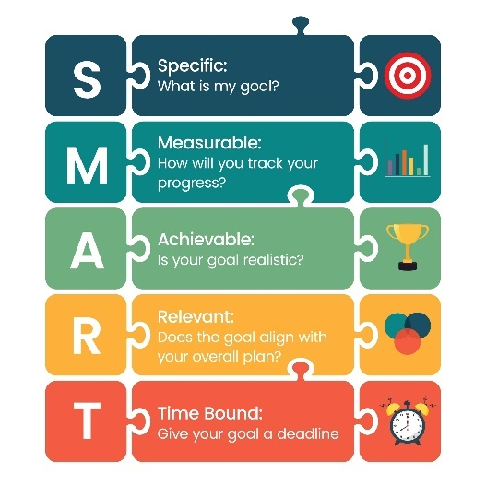
Goal setting
Specific – use action verbs.
Measurable – create process/action measures, e.g. number of days per week
Achievable/agreed – realistic for the person and agreed with them.
Relevant – relate to the individual’s objectives.
Time-framed – create a target time or date.

Slide 19
Other motivational strategies
Praise and encouragement
Track progress, e.g. could be review and checks or could be using devices like watches.
Affirmative statements – accentuate the positive
Rewards
Preparation for relapse support strategies
What are examples of rewards?
How do this build motivation?

Slide 20
Termination, lapse or relapse
Termination
permanently left cycle – behaviour has changed.
Relapse or lapse
returned to old behaviour and left the cycle.
can happen at any of the previous stages:
  a lapse is a short-term setback
  a relapse is a more challenging setback.
Pair task:
What are some examples of lapse and relapse?
How would you support someone?

Slide 21
Overview of strategies
In the early stages of the change process - reframe thinking and remove barriers and obstacles (including their own limiting beliefs).
When the decision to change is made – support action for behaviour change.
Strategies:
Share information – leaflets, conversations
Decisional balance
Likert Scales
Goal setting
Reviews
Rewards
Relapse support strategies

Slide 22
Pair task
What are two main take away points from this lesson?
How will you apply these when programming and delivering for clients with long term health conditions?

Slide 23
Summary
The main principles of the transtheoretical model (TTM).
Effective motivational strategies and techniques that can be used to support participants to adhere to physical activity and support lifestyle behaviour(s) change.

Slide 24
COM-B and Health belief model
Session B

Slide 25
Content
The main principles of the COM-B model and health belief model.
Effective motivational strategies and techniques that can be used to support participants to adhere to physical activity and support lifestyle behaviour(s) change.

Slide 26

COM-B
Share your thoughts and ideas:
What do you currently know about COM-B?

Slide 27
COM-B
= Behaviour
Capability
Opportunity
Motivation

Slide 28
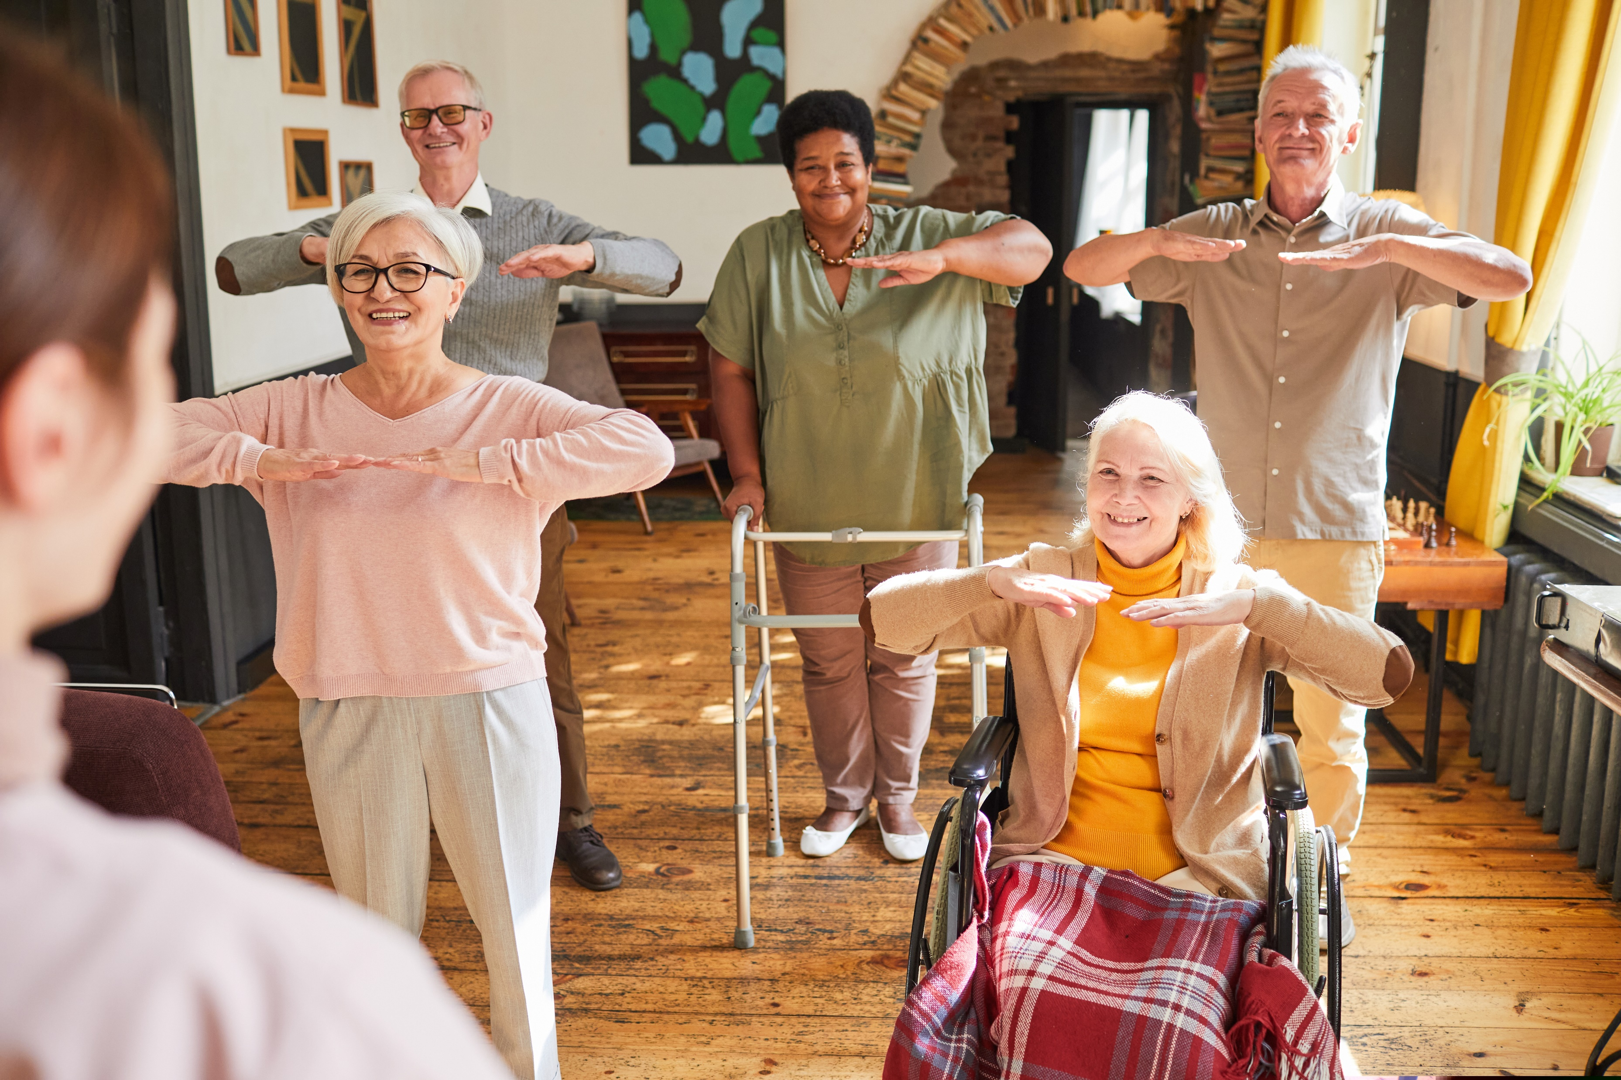
COM-B
Capability refers to someone’s psychological and physical capabilities to do something.
Opportunity relates to social, environmental, and physical factors external to the person which can influence their ability to do something.
Motivation refers to both the conscious (reflective) and subconscious (automatic) motivation and emotions that someone feels, which ultimately determines whether they do something.

Slide 29
COM-B
Capability: Can the person do this?
  Are they physically and psychologically able?
  Will their body and mind allow this?
Opportunity: Is there potential for them to do it?
  Are there opportunities in their daily routine to enable this?
  How does their physical and social environment enable this?
Motivation: Is this something they want to do it?
  Is there a reason for them to do this?
  Do their habits and behaviours drive them towards change?
  Do their beliefs and plans drive them towards change?
Pair task:
Find some example of barriers to:
Capability
Opportunity
Motivation.
Think about how you may overcome these barriers to support behaviour.

Slide 30
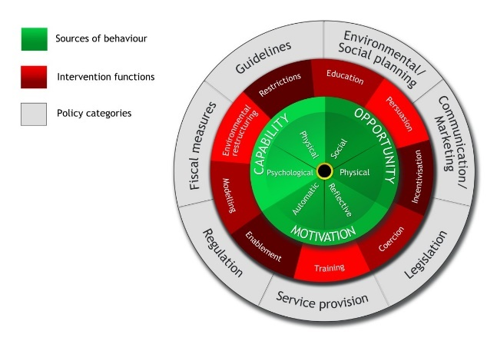
The behaviour change wheel
Source: Michie, S., van Stralen, M.M. & West, R. (2011)

Slide 31

Health belief model
Share your thoughts and ideas:
What do you currently know about this model?

Slide 32
Health belief model
Change is most likely to occur if the individual believes that:
They are vulnerable to or at risk of a problem, e.g. inactivity or their diet presents a risk to their health (perceived vulnerability/susceptibility).
The consequences they perceive relating to the risk/problem cause them concern (perceived severity/consequences).
The action they need to take will provide benefits, e.g. changing their behaviour (perceived benefits, effort and self-efficacy).
The benefits of the action outweigh any barriers (perceived barriers).

Slide 33
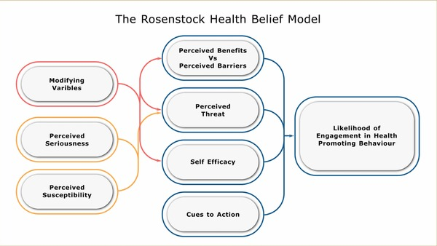
Health belief model

Slide 34
Pair task
What are two main take away points from this lesson?
How will you apply these when programming and delivering for clients with long term health conditions?

Slide 35
Content
The main principles of the COM-B model and health belief model.
Effective motivational strategies and techniques that can be used to support participants to adhere to physical activity and support lifestyle behaviour(s) change.

Slide 36
Person-centred, biopsychosocial model and self- determination theory
Session C

Slide 37
Lesson content
The main principles of behaviour change models and theories:
Person-centred approaches – core conditions
Biopsychosocial model
Self-determination theory

Slide 38

Person-centred approaches
Share your thoughts and ideas:
What do you currently know about person-centred approaches?

Slide 39
Core conditions – Carl Rogers
In a conducive environment (core conditions), the person will grow towards becoming more self-accepting and trusting of themselves and their ability to make the best choices for themselves.
Empathy - being able to put oneself in the position of the other person, to stand in their shoes and see things how they see them, from their perspective and frame of reference (Hough. 1994:p34).
Unconditional positive regard is respecting, valuing, and holding a genuine appreciation and compassion for the person.
Congruence is about being real, genuine, open and transparent. It is behaving and acting in accordance with one’s own values and beliefs.

Slide 40
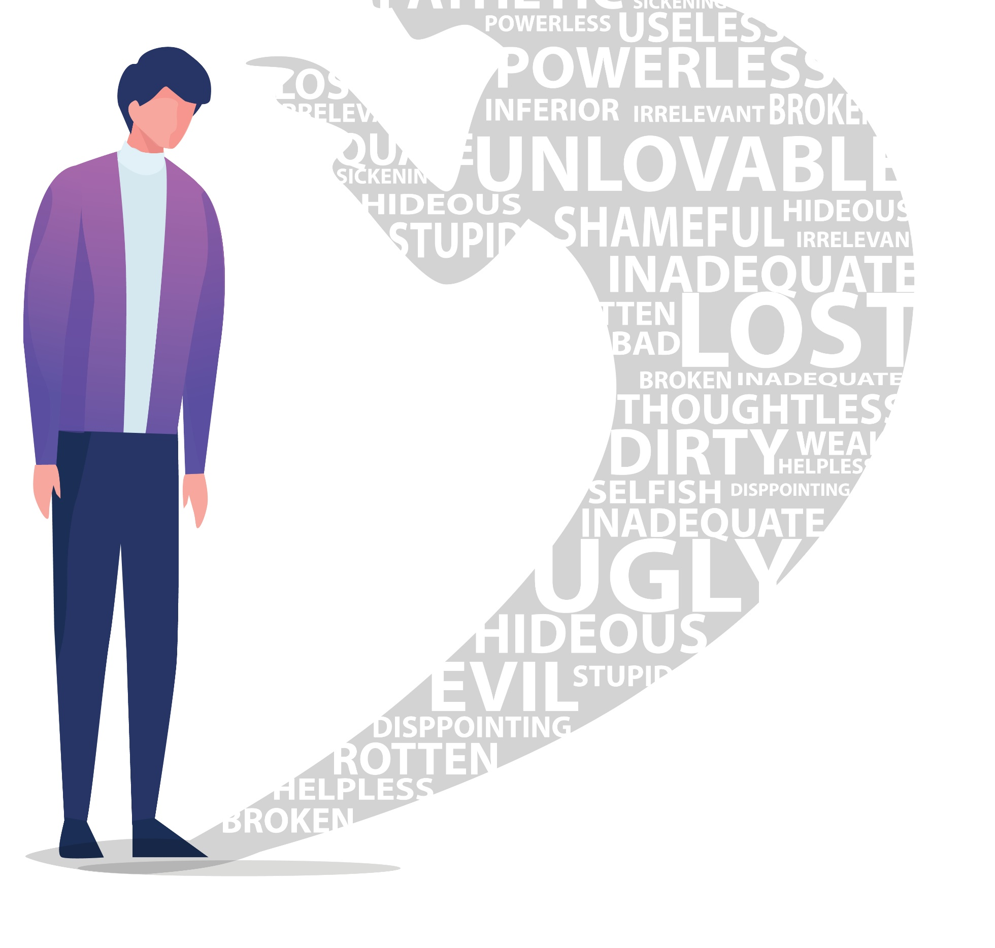
Person centred – self-concept
In a non-conducive environment where disapproval, judgement, rejection, blame, shame etc are experienced, the person’s concept of self will become diminished and conditioned.
They will seek to protect themselves against further negative experiences (defences) and become over-reliant on others for approval and validation.

Slide 41
Working in a person-centred way
To work in a person-centred way:
Create a conducive environment – core conditions.
Build a relationship with the person.
Move at their pace (non-directive).
Believe in the person and their ability to make the right choices for themselves – as their own best expert.
Use lots of active listening.
Hold hope.
Trust that they have all the resources they need inside to achieve their full potential (according to their values).

Slide 42

Biopsychosocial model
Share your thoughts and ideas:
What do you currently know about this model?

Slide 43
Biopsychosocial model
The main premise being that because factors that influence health are multi-factorial, the approach taken to managing and supporting these also needs to be multi-factorial.
All factors need to be considered:
Biological factors include – genetics, disease, hormones, lifestyle factors (diet, exercise, drugs, alcohol etc).
Psychological factors include – beliefs, emotions, resilience, self-esteem, coping skills, emotional intelligence, cognitive biases, intelligence quotient (IQ) etc.
Social factors include - upbringing, family/peer relationships, poverty, school, media, culture, work, stress, health inequalities, discrimination etc.
Can you find a specific example of how each of these factors:
May contribute to someone's health.
Could be managed to support someone’s health.

Slide 44

Self-determination theory (SDT)
Share your thoughts and ideas:
What do you currently know about SDT?

Slide 45
Self-determination theory
Ryan and Deci (1995) suggest people can be either proactive and engaged or passive and alienated (part of meta-theory) and this is largely in response to the social conditions in which they develop and function.
Motivation will be enhanced in environments where innate needs (basic psychological needs theory) are supported and will foster the most volitional and quality forms of motivation (Biddle and Mutrie. 2001:80).

Slide 46
Self-determination theory
Innate needs (basic psychological needs theory) include:
Competence: having some control of outcomes, experiencing success and mastery
Autonomy: being able to make one’s own choices and decisions
Relatedness: being in a supportive, collaborative and cooperative environment and feeling connected to others.

Slide 47
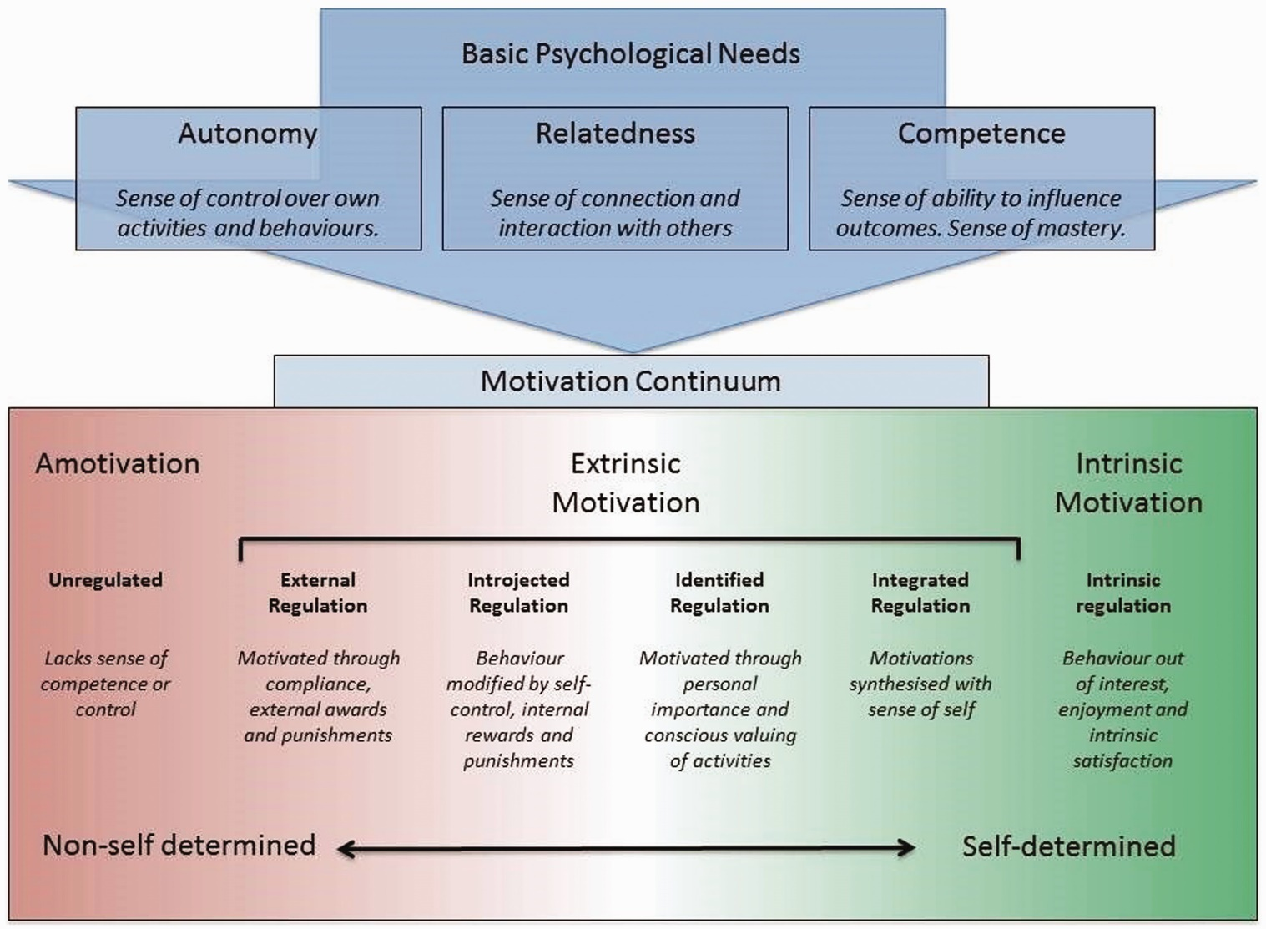
Self-determination theory
Sourced from: https://journals.sagepub.com/doi/10.1177/1742395319845427. Hanlon P, Gray CM, Chng NR, Mercer SW. Does Self-Determination Theory help explain the impact of social prescribing? A qualitative analysis of patients’ experiences of the Glasgow ‘Deep-End’ Community Links Worker Intervention. Chronic Illness. 2021;17(3):173-188. doi:10.1177/1742395319845427

Slide 48
Pair task
What are two main take away points from this lesson?
How will you apply these when programming and delivering for clients with long term health conditions?

Slide 49
Summary
The main principles of behaviour change models and theories:
Person-centred approaches – core conditions
Biopsychosocial model
Self-determination theory

Slide 50
Level 3 Programming, adapting and delivering exercise for adults with long-term health conditions.
Behaviour change models

