Slide 1
Level 3 Programming, adapting and delivering exercise for adults with long-term health conditions.
Delivery and evaluation

Slide 2
Session content
How to utilise and adapt communication and instructional skills to monitor and improve performance.
The importance of correct instructions and demonstration of safe and effective exercise techniques.
How to tailor delivery methods to meet the needs of a range of participants.
Effective motivational strategies and techniques to support participants to adhere to physical activity and support lifestyle behaviour(s) change.
How to apply relevant behaviour change theory and techniques to design a programme to meet the needs of individuals.
The importance of regular reviews of the participant’s progress.
Opportunities to collect feedback from participants.
How to use the information gathered from participant feedback to promote motivation, adherence and outcome success.
How to reflect on your practice to inform future sessions.

Slide 3

Instructional skills
What are essential instructor skills?
What are examples of motivational strategies?

Slide 4
Instructor skills – general
General instructor skills are to:
Demonstrate correct alignment.
Provide clear verbal instructions.
Use appropriate voice projection and intonation.
Adopt appropriate teaching positions to observe clients and respond to their needs.
Provide teaching points (verbal and visual).
Modify and adapt exercises, e.g. offering alternatives.
Provide corrective strategies to support individuals’ techniques.
Monitor the safety and intensity of exercise.
How may these skills need to be adapted and enhanced when working with clients with long-term health conditions.
Why are these skills important?
(think risks!)

Slide 5
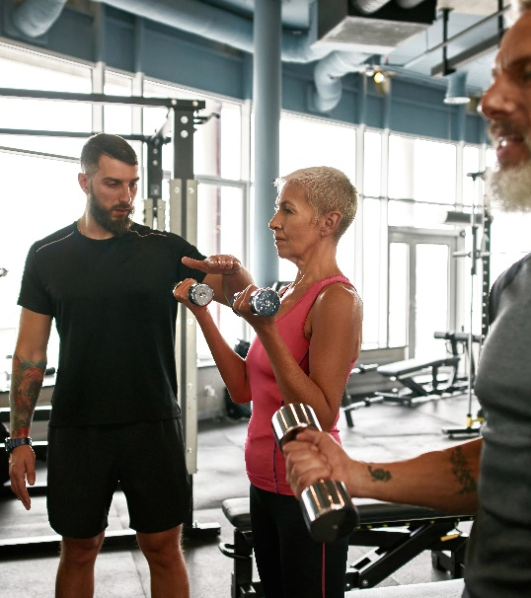
Importance of instructional skills
Safe and effective alignment.
Appropriate intensity.
Assist and reduce risks.
Maximise effectiveness and outcomes.
Promote adherence.
Build confidence and trust.
Inform and educate.

Slide 6
Motivational strategies
Inclusion and welcoming.
Knowing names.
Engage with individuals – ‘get to know them’.
Praise.
Encouragement.
Positive affirmative statements.
Accentuate the positive.
Identify improvements/changes.
Opportunities to build community – social support.
Rewards.
Why are these important?
What other motivational strategies can be used?

Slide 7

Evaluation and reflective practice
Why are reviews important?
When do these happen?
How can information be used?

Slide 8
Review stages
When:
Initial consultation - to gather baseline information to inform programme design.
Weekly check-ins at every session to enable tailoring, modification and adjustment for specific needs.
Mid-programme review halfway through the planned programme - review and check progress.
End-programme review at the end of the programme - review and check progress.
Importance:
Use the information to feedback to clients and service (where appropriate).
Opportunities for feedback
Every session – before, during and after session
Verbal or written

Slide 9
Reflective practice
Reflection-in-action: During a session, an instructor will be observing and listening to individuals to monitor the effect of exercise and the individual’s experience.
What they observe and/or hear may give rise to the modification of a specific exercise to meet an individual’s needs, the reinforcement of teaching points, reducing or increasing an intensity variable etc.
It may also give rise to the use of a different teaching method to deliver information, such as using different teaching points, using visualisations, changing teaching positions or re-demonstrating an exercise.
Reflection-on-action: At the end of a session, an instructor will think back to the whole session and feedback received from clients, which may make them rethink the session structure, choice of exercises, intensity variables, teaching methods etc.

Slide 10
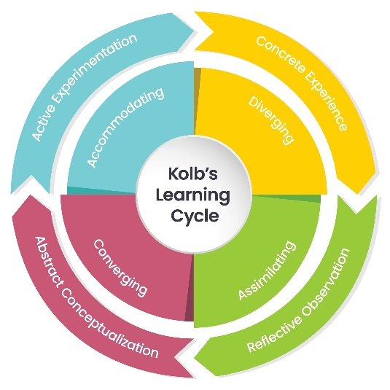
Kolb model
Do something, e.g. deliver a session or an exercise.
Think about it, e.g. consider and evaluate what works and what does not work.
Consider how to make improvements, e.g. changes that could be made to support the individual(s).
Put learning into practice – experiment.
Repeat the process.

Slide 11
Continuing professional development (CPD)
Reading journals, articles, or books from reputable sources about specific conditions or approaches to support behaviour change.
Researching a health condition or medication via the internet.
Engaging with other healthcare professionals e.g. GP, physiotherapists, diabetes care teams, respiratory nurses etc).
Attending relevant and related workshops with reputable organisations.
Independent research, such as finding out more about the barriers to becoming active for individuals with health conditions.

Slide 12
Continuing professional development (CPD)
Mentoring and coaching from other professionals.
Gaining additional training and qualifications, for example, pulmonary rehabilitation, cardiac rehabilitation, falls prevention and management, menopause, behaviour change, motivational interviewing, health policy, other health conditions (neurological, cancer), and/or palliative care.
Exploring support strategies for managing own emotional resilience.
Learning from clients, their experience of the health conditions etc.

Slide 13
Pair task
What are two main take away points from this lesson?
How will you apply these when programming and delivering for clients with long term health conditions?

Slide 14

Practical workshops

Slide 15
Practical activity
Tutor to allocate applied case studies (available in LAR).
    NB: only use case studies within scope (one CS within each set exceeds scope).
Learners to draft a session plan to meet case study needs
Learners to deliver each specific component of a session to meet client needs and evaluate practice. (warm up, CV, RT, cooldown)
Tutor to provide feedback.

Slide 16
Pair task
What are two main take away points from this lesson?
How will you apply these when programming and delivering for clients with long term health conditions?

Slide 17
Summary
How to utilise and adapt communication and instructional skills to monitor and improve performance.
The importance of correct instructions and demonstration of safe and effective exercise techniques.
How to tailor delivery methods to meet the needs of a range of participants.
Effective motivational strategies and techniques to support participants to adhere to physical activity and support lifestyle behaviour(s) change.
How to apply relevant behaviour change theory and techniques to design a programme to meet the needs of individuals.
The importance of regular reviews of the participant’s progress.
Opportunities to collect feedback from participants.
How to use the information gathered from participant feedback to promote motivation, adherence and outcome success.
How to reflect on your practice to inform future sessions.

Slide 18
Level 3 Programming, adapting and delivering exercise for adults with long-term health conditions.
Delivery and evaluation

