Slide 1
Level 3 Programming, adapting and delivering exercise for adults with long-term health conditions.
Motivational interviewing (MI), cognitive behavioural therapy (CBT) and solution-focused.

Slide 2
Lesson content
Two lessons
The main principles of behaviour change approaches.
Effective motivational strategies and techniques to support participants to adhere to physical activity and support lifestyle behaviour(s) change.
Session A: Motivational interviewing
Session B: CBT and solution-focused

Slide 3
Motivational interviewing (MI)
Session A

Slide 4
Lesson content
The main principles of motivational Interviewing (MI).
Effective motivational strategies and techniques to support participants to adhere to physical activity and support lifestyle behaviour(s) change.

Slide 5

Motivational interviewing
Share your thoughts and ideas:
What do you currently know about motivational interviewing?

Slide 6
Motivational interviewing
One approach to creating helpful, relational and collaborative conversations to support lifestyle change.
A highly skilled approach - practice and experience required to use effectively.
Key principles include:
  Processes – engage – focus – evoke – plan
  Core skills - OARS
  RULE
Further training recommended.
Stephen Rollnick and William Miller

Slide 7
MI is particularly helpful when there is:
High ambivalence – the person is undecided about whether to make a change.
Low self-efficacy – they lack confidence or belief in their ability to make changes.
Low desire – they lack motivation for making a specific change.
Low importance - the desired behaviour is not seen as being important or a priority.
Motivational Interviewing Network of Trainers (MINT. 2021)
Motivational interviewing

Slide 8

Ambivalence
Sustain talk – all the reasons not to make changes
Barriers
Change talk – all the reasons for making changes
Motivators
These present as barriers and motivators for change.

Slide 9
Ambivalence
Activity: Where is the change talk, where is the sustain talk?
‘I know exercise is good for you, but I am really worried I may get injured.’

Slide 10

Self-efficacy
Efficacy expectations - perceived confidence about their ability.
NOT the same as their actual ability!
Outcome expectations - do they see possible actions as making a difference to their current circumstances?

Slide 11
Key sources that inform self-efficacy
Self-efficacy
Own experiences
Experiences of others (role-modelling)
Verbal persuasion
Physiological and affective states

Slide 12
Key sources that inform self-efficacy
Own experiences: Past success builds efficacy, and past failure can reduce efficacy, especially if attached with experiencing uncomfortable emotions/affective states.
Experiences of others (role-modelling): Seeing others, like self-succeeding or failing.
Verbal persuasion: Being influenced by others, especially when their opinion is respected and valued.
Physiological and affective states: How psychological and physiological effects are responded to and managed.

Slide 13
Motivational interviewing processes
Engage
Start the conversation and build rapport
Focus
Identify and agree the purpose of the conversation.
Evoke
Increase motivational language used by the person.
Plan
Establish their commitment and plan the next steps.

Slide 14
The four main processes within MI conversations are:
Engage – start a conversation and build a relationship.
Focus – identify and agree on the purpose of the conversation.
Evoke – increase the person’s use of motivational language (change talk).
Plan – establish their commitment and plan the next steps.
Motivational interviewing processes
This may take several conversations

Slide 15
MI skills - OARS
Open questions - start the conversation, gather information, establish focus and keep the conversation flowing.
Affirming statements (positive statements) - build self-efficacy and confidence.
Reflective statements - demonstrate active listening and accurate empathy.
  A simple reflective – use their words
  A complex reflective – interpret their words – best guess
Summaries draw together several themes that have been discussed.

Slide 16
RULE acronym
Resist the righting reflex - not trying to fix the person at every opportunity.
Understand and explore the individual’s motivations.
  what they want to achieve.
  importance and confidence.
Listen with empathy, curiosity, and acceptance.
  hear the barriers (sustain talk) without placing too much importance on these.
  affirm the change talk.
Empower the person – their choice.

Slide 17
Evoking - skills
Encourage the person to speak about WHY (the reasons for change).
WHY builds motivation.
To elicit change talk, use.
Open questions
Affirming statements
Reflective statements
Summaries
Tools - decisional balance and Likert scales (sometimes called Rollnick’s ruler)

Slide 18
Decisional balance
What are the benefits of making a change?
What are the benefits of staying the same?
What are the disadvantages of making a change?
What are the disadvantages of staying the same?

Slide 19
Likert scales – Rollnick’s Ruler
1
10
2
3
4
5
6
7
8
9
LOW
HIGH
Ask:
‘Using the 1 to 10 scale - How motivated are you to start taking steps towards stopping smoking?’
‘Using the 1 to 10 scale - How important is this for you?’
‘Using the 1 to 10 scale - How confident do you feel about doing this’

Slide 20
Planning stage skills
This can only happen when a person is ready and when they are predominantly using change talk, and much less sustain talk.
Planning next steps may include:
setting goals if more change talk is being used
making future appointments to discuss the change further.
Signposting information can be shared as part of the planning stage without needing the individual to use more change talk. The person has a choice, they can follow up on the information, or not.

Slide 21
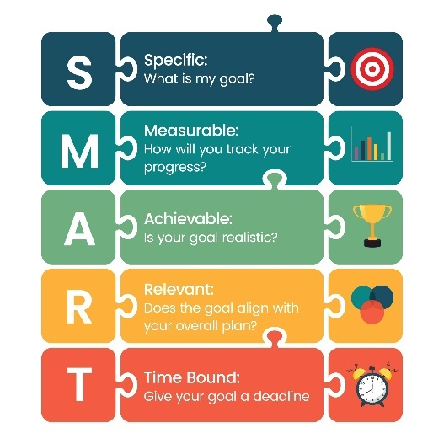
Goal setting
Specific – action verbs.
Measurable – process/action measures, e.g. number of days per week.
Achievable/agreed – realistic for the person and agreed with them.
Relevant – relate to the individual’s objectives.
Time-framed – target time/date stated.

Slide 22
GP surgeries
Exercise referral services
Physical activity
Psychological therapies and counselling
Smoking cessation
Alcohol support
Signposting
What other services to meet different needs?

Slide 23
Pair task
What are two main take away points from this lesson?
How will you apply these when programming and delivering for clients with long term health conditions?

Slide 24
Summary
The main principles of motivational Interviewing (MI).
Effective motivational strategies and techniques to support participants to adhere to physical activity and support lifestyle behaviour(s) change.

Slide 25
Cognitive behavioural therapy (CBT)
Session B

Slide 26
Lesson content
The main principles of cognitive behavioural therapy.
Effective motivational strategies and techniques that can be used to support individuals and groups to change their physical activity and lifestyle behaviour(s).

Slide 27

Cognitive behavioural therapy (CBT)
Share your thoughts and ideas:
What do you currently know about CBT?

Slide 28
Cognitive behavioural therapy (CBT)
A skilled therapy requires further training.
Primary concepts:
Irrational beliefs.
ABC model (antecedent, behaviour, consequence).
Automatic thoughts (NATs or ANTs).
Cognitive errors or distortions.

Slide 29
Irrational beliefs
Contribute to stress and suffering.
Include self-deprecating statements, awfulizing or catastrophising situations, and the demands someone may make on themselves.
Some examples include:
“I must always do everything well, or I am incompetent”
“I can never make a mistake, or I'll be seen as a failure”.

Slide 30
ABC model
Antecedent – the activating event | Beliefs - inferences made from the event | Consequences – effects on emotions and behaviour
Irrational response
Lapsing or relapsing as part of the change cycle | It is awful I can’t do this I am a failure I am useless | Depressed Hopeless Give up and reverts to old behaviour
Rational response
Lapsing or relapsing as part of the change cycle | It was disappointing I can start again It is not the end of the world I have done it once, so I can do it again | Feels disappointed Makes plans to restart Keeps going

Slide 31
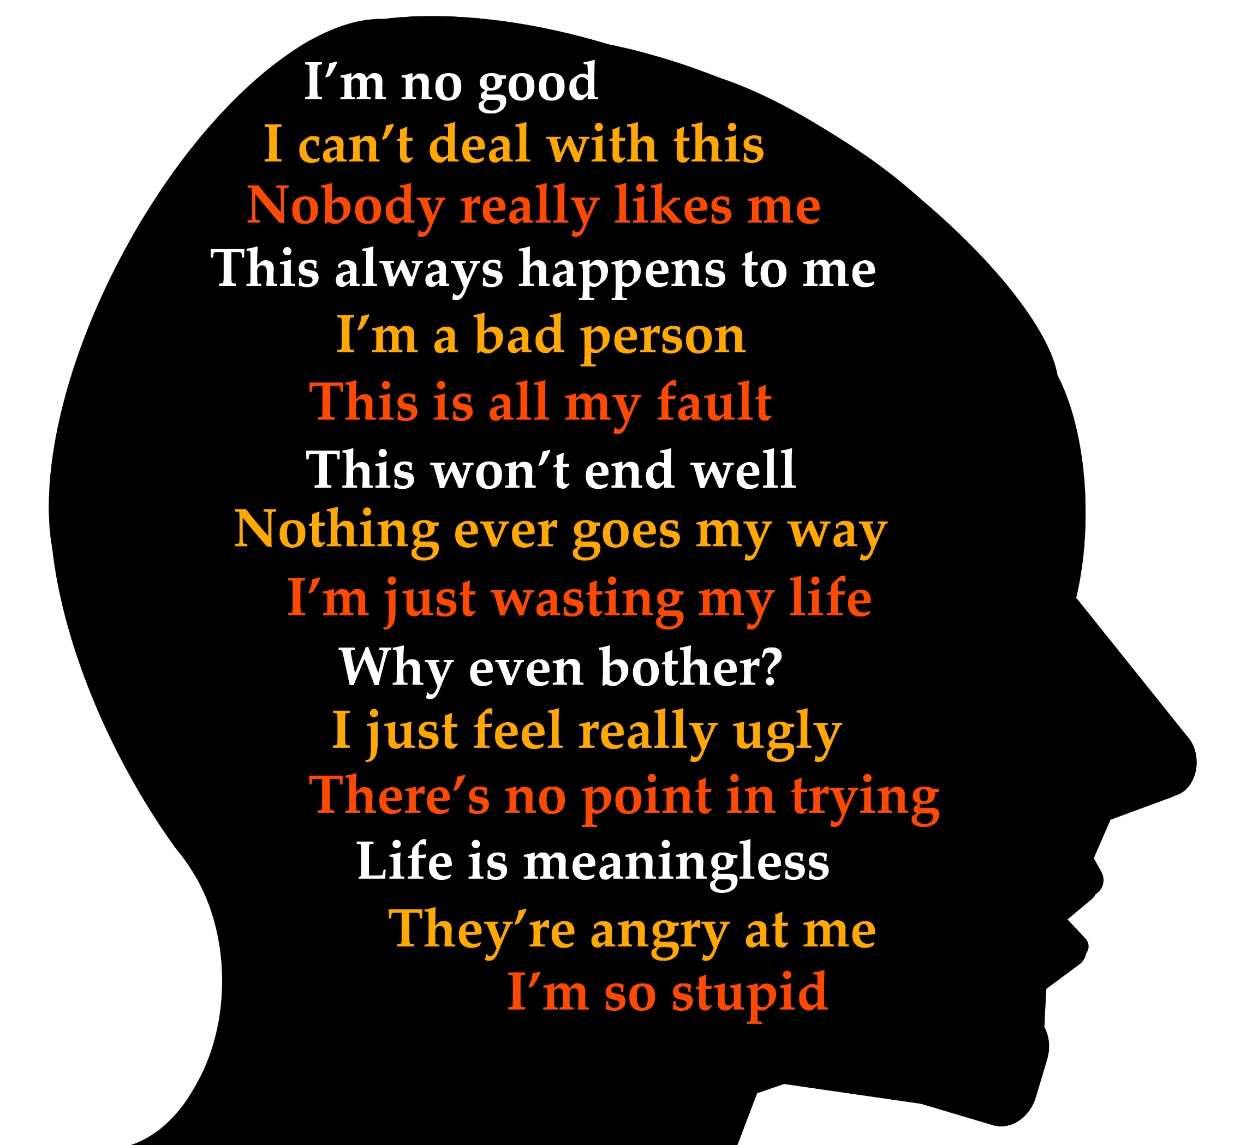
Negative automatic thoughts (NATS or ANTS)
Most thoughts (cognitions) are automatic and at the edge of awareness.
Thoughts can be supportive or unsupportive.
Negative automatic thoughts (NATs) are those that are unhelpful.
Recognising NATs offers a way of changing or reprogramming these towards more supportive thinking patterns.

Slide 32
Cognitive distortions
Cognitive distortion or error | Description
All or nothing thinking (absolutistic) | Seeing things as extremes, black and white with no middle ground, e.g. marvellous or terrible.
Jumping to conclusions (arbitrary inference) | Drawing conclusions from experiences without supporting evidence.
Should and must statements | Criticising self or others, - you or I “should”, “must”, “have to” etc.
Discounting the positives | Not taking account of one’s positive qualities or achievements.
Fortune telling | Predicting the worst.
Personalisation | Taking everything personally and either blaming self or others.
Magnification and minimisation | Blowing things out of proportion and making things more important or less important than they are
Overgeneralisation | Seeing an isolated experience as a never- ending pattern of defeat
Labelling | Labelling self in response to a situation, e.g. instead of ‘I made a mistake, labelling self as an idiot

Slide 33
CBT techniques
Education – raising awareness of different thinking patterns, reality testing thought distortions and raising awareness of the impact of thoughts on behaviour (ABC).
Bibliotherapy – the use of self-help books, e.g. assertiveness etc.
Homework - the use of diaries to monitor thinking patterns or mood.
Role play - rehearsing situations, e.g. saying ‘no’ when someone offers a cigarette.
Positive reinforcement – using affirmative statements to reinforce desired behaviours.
Relaxation and breathing techniques - to help cope with anxious feelings in stressful situations.
Scheduling tasks and activities – setting time aside during the day to commit to a goal, e.g. attending an activity session.

Slide 34

Solution-focused
Share your thoughts and ideas:
What do you currently know about solution-focused working?

Slide 35

Solution-focused
Steve de Shazer & Insoo Kim Berg
Solution-focused brief therapy (SFBT. 1970’s)
Founded on the underlying premise that people like to speak about their problems, and this causes them to become stuck in a problem-focused cycle of thinking.
Future focused and goal-directed.
Brief therapy – trained therapists sometimes only need one session with a client.

Slide 36
Solution-focused
As a therapy, each session is treated as a complete piece of work and will consist of four stages.
Find the solution or goal.
Action and monitoring
Review and adapt (maybe in a follow-on session)
Develop an action plan

Slide 37
Solution-focused
Stage 1
Validate problems without over-emphasising them.
Help the individual define their ideal future and what they want (possible solutions, best hopes, preferred future, miracle questions and setting goals).
Stage 2
Creating a way for them to get where they want to be (action planning, small steps, exploring resources and strengths they have, generating possibilities).
Stage 3
Action and commitment (sealing the individual’s commitment and the actions they plan to take and how this can be monitored and checked).
Stage 4
Checking progress towards goals (use of scaling - Likert scales, affirming strengths and successes, accentuating the positive building self-efficacy, reframing thinking, empowering the person).

Slide 38
Solution-focused - questions
Coping with the problem questions
How have you managed a problem in the past? What support did you receive? What else? | What is going well and doesn’t need to change? When has a problem become less? What role did you play in managing this? What changed? What else?

Slide 39
Solution-focused - questions
Best hope questions
What are your best hopes for this work? What differences would you like to see because of this session? What else?
Preferred future questions
What would you prefer to have in your future instead of this and how will you notice? What else?

Slide 40
Solution-focused - questions
Miracle questions
If you woke up tomorrow morning and everything had changed, what would be the first thing you noticed? What else would you notice? Who else may notice? What would they notice?
Action questions
What skills do you have to make this happen? How can you use your strengths to do what is needed now? What do you need to start doing? What do you need to stop doing? What support may you need?

Slide 41
Solution-focused - questions
Monitoring questions
We have agreed that you will do X, Y, Z…… How can we monitor to check if this happens?
Follow-on session questions – review and adapt
What has worked well since we last spoke?’ What has got better since we last met? What else? What would need to happen to make today’s sessions really useful for you? What else? Is there anything else that might work better for you?

Slide 42
Pair task
What are two main take away points from this lesson?
How will you apply these when programming and delivering for clients with long term health conditions?

Slide 43
Summary
The main principles of cognitive behavioural therapy and solution-focused.
Effective motivational strategies and techniques can be used to support individuals and groups to change their physical activity and lifestyle behaviour(s).

Slide 44
Level 3 Programming, adapting and delivering exercise for adults with long-term health conditions.
Motivational interviewing (MI), cognitive behavioural therapy (CBT) and solution-focused.

