Slide 1

Development Stages of Children and Young People
Paul Bailey

Slide 2
Life stages
Infancy 0-2 yrs
Early childhood 3-8 yrs
Adolescence 9-18 yrs
Adulthood 19-45 yrs
Middle adulthood 45-65 yrs
Later adulthood 65+ yrs

Slide 3
Physical development
Physical development is governed by hormone secretion. It is not the same for every child.

Slide 4
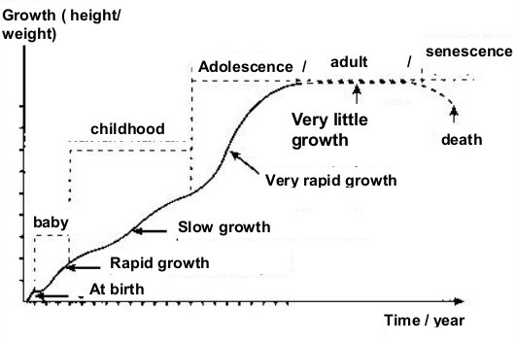
Human growth
There are of course growth considerations for children in sport and physical activity!

Slide 5
Biological/chronological/training age
Crucially, growth due to the onset of puberty occurs at different times and at different rates for children. Therefore, children of the same chronological age may be disadvantaged against children of a higher biological age. Differentiation must occur in order to provide child-specific programmes from a safety and a developmental point of view
Additionally, training age must be taken into account. A child with a higher training age, but lower biological or chronological age of a peer may be capable of more from a strength or motor skill perspective

Slide 6
Peak Height Velocity (PHV)
Peak Height Velocity is the age at which physical growth is most rapid and corresponds to the peak of puberty. Prior to PHV, a child will display younger physical characteristics. Beyond PHV, a child will show more adult characteristics including secondary sexual characteristics.
It is possible to calculate PHV from measurements of standing height and sitting height. A calculator with an explanation of how to take these measurements can be found here: https://wwwapps.usask.ca/kin-growthutility/phv_ui.php

Slide 7
Childhood strength
Throughout childhood strength increases in a linear fashion
Strength increases in childhood appear to be related to development of the central nervous system:
  Motor unit recruitment
  Firing frequency
  Synchronisation
  Neuro myelination (myelin sheath increasing conductivity of nerves)

Slide 8
Adolescent strength
Strength increases at onset of puberty
  Boys strength increases are significantly greater from this point
  Girls strength increases are still relatively linear from this point
Strength increases result due to presence of androgens including:
  Testosterone
  Human Growth Hormone
  Insulin-like growth factor
Increases in strength are the result of:
  Increase in cross-sectional area
  Muscle pennation angle (direction of muscle fibre within the muscle)
  Muscle fibre differentiation (fast/slow)

Slide 9
Motor skills
Gross and fine motor experiences develop incrementally throughout early childhood, starting with sensory explorations and the development of a child’s strength, co-ordination and positional awareness through tummy time, crawling and play movement with both objects and adults.
Gross motor (physical) skills are those which require whole body movement and which involve the large (core stabilising) muscles of the body to perform everyday functions, such as standing, walking, running, and sitting upright. It also includes eye-hand coordination skills such as ball skills (throwing, catching, kicking).
Fine motor skills are those which requires accuracy and delicacy to perform. Fine motor control and precision helps with hand-eye co-ordination which is later linked to early literacy. Repeated and varied opportunities to explore and play with small world activities, puzzles, arts and crafts and the practise of using small tools, with feedback and support from adults, allow children to develop proficiency, control and confidence.

Slide 10
Gross motor skills
Gross motor skills are the skills that children develop using their whole body. You can see this from a baby’s earliest efforts to move and travel, to young children coordinating whole body movements. By using their whole bodies children become increasingly confident, agile and flexible.
All children need to be confident in their gross motor skills and movements. For some children this confidence will come in smaller steps and take longer to achieve. Be patient, giving them time and space, and encouraging words. Take expert advice for children with physical and mobility additional needs. This may increase childrens’ development of muscular strength, ability to take well intentioned, safe risks and become increasingly well-coordinated.
Gross motor skills affect wellbeing and give children opportunities to socialise in play. Confidence and coordination in gross motor skills are essential for children in developing their fine motor skills.

Slide 11
Fine motor skills
Fine motor skills involve small muscles working with the brain and nervous system to control movements in areas such as the hands, fingers, lips, tongue and eyes. Developing fine motor skills helps children do things like eating, writing, manipulating objects and getting dressed.
A baby uses their fingers and thumbs to pick things up. They will also feel and taste objects with their mouth and lips. An older child will use their fine motor skills for actions like pulling up a zip or using scissors to cut up paper. These important skills will contribute to a child’s development and independence across all areas of learning.
Research shows that the development of fine motor skills depends on the development of gross motor skills and that a joined-up approach to physical development is important. Young children need many opportunities to develop fine motor skills alongside gross motor skills so they can become confident to explore the world around them.
From a very young age, children are exploring different materials. With these materials a child will naturally start to make marks. Babies might use their whole bodies to make marks with mud, paint or cornflour in a tuff tray, or with food at mealtimes. A toddler might splash in a puddle and notice the prints they make.
Mark making is an important experience for children because over time they can attribute meaning to their marks. Combined with a child’s developing dexterity, these marks become refined and deliberate, until the point at which the young child labels their marks, either as pictures or writing.

Slide 12
Physical and motor skill milestones
Throughout our development there are movement milestones that are recommended.
General milestones may include:
Being able to rollover by 6 months
Sitting, crawling and walking by 18 months
Kicking a ball and being able to hop by 4 years
Able to skip and run lightly on toes by 6 years
As children get older, milestones will be specific to the child and their chosen activities. Most sports governing body’s have now analysed their own sport and produced a timeline of development required to make a world class athlete. An example of how one sport expects a child to develop is on the next slide.

Slide 13
BMX physical and motor skill milestones
BMX Racing is an Olympic sport. As such, the governing body of he sport, British Cycling have set out a development framework for a world class BMXer:
Regional School of Racing - By age 12/13/14/15/16
60m sprint time under – Boys 6.75 seconds, girls 7.0 seconds
Wheelie distance of – Boys 20+ metres, girls 10+ metres
Manual distance of – Boys 15+ metres, girls 8+ metres
Bunny hop height of – Boys 45cms, girls 30cms
Jump distance of – Boys 2.5m, girls 1.5m
National School of Racing - By age 14/15/16
50m sprint time under – Boys 6.5 seconds, girls 6.75 seconds
Manchester 5m hill time – Boys 2.7 seconds, girls 2.9 seconds
Manchester 5m lap time – Boys 32.5 seconds, girls 35.5 seconds
Peak power – Boys 1000W, girls 850W
Peak cadence – Boys 150rpm, girls 135 rpm

Slide 14
Factors influencing physical and motor development
Sedentary lifestyle
Lack of opportunity to develop all areas of physical ability
Injury (eg. Broken bone)
Disability (eg. Cerebral palsy)
Brain injuries which might impact upon physical ability
Socio-economic

Slide 15
Social
Infant
Attachment relationships are important for children to develop. This acts as a model for later adult relationships. Other relationships include parents, siblings, grandparents etc. A lot of learning comes through play. This starts as solo play and then sharing begins.
Early childhood
Children widen their social group and form friendships with others; but often get temper tantrums if they do not get their own way. As they begin to cooperate with other they make more friends and by the age of 8 most children have a best friend. Children might start being a little more independent and perform tasks for themselves during this stage
Adolescence
Friendship and friendship groupings are important at this stage. You socialise more and develop more freedom from parents/carers. Independence develops (eg. Learning to drive). Peer pressure may lead to experimentation.

Slide 16
Factors influencing social development
Family/siblings
Attending play groups and pre school
Communication difficulties
Cultural factors
Disability/learning difficulty
Psychological health

Slide 17
Emotional
Infant
Babies bond with their primary care giver. This is called an ‘attachment’, and normally occurs between 7 and 12 months. Babies are wary of strnagers. It is important to show babies love and affection. Infants cry when uncomfortable and coo when happy.
Early childhood
Children learn how to handle their feelings as well as sharing and cooperation. This leads to playing together in team games. Children can now tell others when they feel happy or sad. It is important to nurture a child, showing them love and affection.
Adolescence
Self image and self esteem are effected in adolescence. Self image is the way you view yourself; this could be influenced by bullying or compliments. Self esteem is related to the level of confidence you have. Mood swings are common due to fluctuating hormones. Sexuality develops at this stage.

Slide 18
Factors influencing emotional development
Transitions such as moving school
Bereavement
Traumatic experiences
Positive experiences

Slide 19
Cognitive
Cognition is the process of acquiring knowledge. As the brain develops with age, so does cognition.
Infant development
Learn individual words (perhaps 6 by age 18 months)
Early childhood development
Knowledge is gained from experiential learning as well as questioning.
Adolescent development
Abstract and creative thinking occurs in this stage. Abstract thinking means to think about concepts and ideas without objects (eg. Equations). Creative thinking occurs when trying to think about new ideas (eg. in art)

Slide 20
Piaget’s 4 stages of cognitive development
Jean Piaget’s theory suggests that intelligence changes as children grow. The theory explains that a child’s cognitive development is not just about acquiring knowledge but also constructing a mental model of the world. Cognitive development occurs through the interaction of innate capacities and environmental events, and children pass through a series of stages:
All children go through the same stages in the same order, but at different rates depending upon biological maturation and interaction with the environment.
Each stage, requires a different type of intelligence.
Stage | Age | Goal
Sensorimotor | Birth – 18-24 months | Object performance
Preoperational | 2 – 7 years | Symbolic thought
Concrete operational | 7 – 11 years | Logical thought
Formal operational | 12 years + | Scientific reasoning

Slide 21
Sensorimotor stage
During this stage the focus on physical sensations and on learning to coordinate the body.
The infant learns about the world through their senses and through their actions (moving around and exploring its environment).
During the sensorimotor stage a range of cognitive abilities develop. These include: object permanence; self-recognition (the child realises that other people are separate from them); deferred imitation; and representational play.
They relate to the emergence of the general symbolic function, which is the capacity to represent the world mentally
At about 8 months the infant will understand the permanence of objects and that they will still exist even if they can’t see them and the infant will search for them when they disappear.

Slide 22
Sensorimotor stage cont.
During this stage the infant lives in the present. It does not yet have a mental picture of the world stored in its memory therefore it does not have a sense of object permanence. If it cannot see something then it does not exist. This is why you can hide a toy from an infant, while it watches, but it will not search for the object once it has gone out of sight.
The main achievement during this stage is object performance – knowing that an object still exists, even if it is hidden. It requires the ability to form a mental representation (i.e., a schema) of the object.

Slide 23
Preoperational stage
At the beginning of this stage the child does not use operations, so the thinking is influenced by the way things appear rather than logical reasoning. A child cannot conserve which means that the child does not understand that quantity remains the same even if the appearance changes. Furthermore, the child is egocentric; they assume that other people see the world as he does. This has been shown in the three mountains study.
Toddlers and young children acquire the ability to internally represent the world through language and mental imagery.
During this stage, young children can think about things symbolically. This is the ability to make one thing, such as a word or an object, stand for something other than itself.
A child’s thinking is dominated by how the world looks, not how the world is. It is not yet capable of logical (problem solving) type of thought.
Moreover, the child has difficulties with class inclusion; he can classify objects but cannot include objects in sub-sets, which involves classify objects as belonging to two or more categories simultaneously
Infants at this stage also demonstrate animism. This is the tendency for the child to think that non-living objects (such as toys) have life and feelings like a person’s.

Slide 24
Preoperational stage cont.
By 2 years, children have made some progress towards detaching their thought from physical world. However, they have not yet developed logical (or 'operational') thought characteristics of later stages. Thinking is still intuitive (based on subjective judgements about situations) and egocentric (centred on the child's own view of the world).

Slide 25
Concrete operational stage
By the beginning of the concrete operational stage, the child can use operations ( a set of logical rules) so they can conserve quantities, they realise that people see the world in a different way than they do (decentring) and they have improved in inclusion tasks. Children still have difficulties with abstract thinking.
During this stage, children begin to thinking logically about concrete events.
Children begin to understand the concept of conservation; understanding that, although things may change in appearance, certain properties remain the same.
During this stage, children can mentally reverse things (e.g. picture a ball of plasticine returning to its original shape).
During this stage, children also become less egocentric and begin to think about how other people might think and feel.

Slide 26
Concrete operational stage cont.
The stage is called concrete because children can think logically much more successfully if they can manipulate real (concrete) materials or pictures of them. Piaget considered the concrete stage a major turning point in the child's cognitive development because it marks the beginning of logical or operational thought. This means the child can work things out internally in their head (rather than physically try things out in the real world).
Children can conserve number (age 6), mass (age 7), and weight (age 9). Conservation is the understanding that something stays the same in quantity even though its appearance changes. But operational thought is only effective here if the child is asked to reason about materials that are physically present. Children at this stage will tend to make mistakes or be overwhelmed when asked to reason about abstract or hypothetical problems.

Slide 27
Formal operational stage
The formal operational period begins at about age 11. As adolescents enter this stage, they gain the ability to think in an abstract manner, the ability to combine and classify items in a more sophisticated way, and the capacity for higher-order reasoning.
Adolescents can think systematically and reason about what might be as well as what is (not everyone achieves this stage). This allows them to understand politics, ethics, and science fiction, as well as to engage in scientific reasoning. Adolescents can deal with abstract ideas: e.g. they can understand division and fractions without having to actually divide things up. Solve hypothetical (imaginary) problems.
Concrete operations are carried out on things whereas formal operations are carried out on ideas. Formal operational thought is entirely freed from physical and perceptual constraints.
During this stage, adolescents can deal with abstract ideas (eg. no longer needing to think about slicing up cakes or sharing sweets to understand division and fractions).
They can follow the form of an argument without having to think in terms of specific examples.
Adolescents can deal with hypothetical problems with many possible solutions. Eg. if asked ‘What would happen if money were abolished in one hour’s time?’, they could speculate about many possible consequences.

Slide 28
Formal operational stage cont.
From about 12 years children can follow the form of a logical argument without reference to its content. During this time, people develop the ability to think about abstract concepts, and logically test hypotheses.
This stage sees emergence of scientific thinking, formulating abstract theories and hypotheses when faced with a problem.

Slide 29
Factors influencing cognitive development
Brain injury
Global delay (a term used when a child takes longer to reach milestones than others the same age)
Learning disabilities or difficulties
Environmental factors
  Social
  Economic
  opportunity

Slide 30
Long Term Athlete Development (LTAD)
LTAD is a term for the continuum of physical development for children. The phrase was coined by Istvan Balyi, and has been used and adapted over the years by educational and sporting establishments to best meet the needs of children in their care.
LTAD accounts for the physical, social, emotional and cognitive stages of development for children and produces a logical, informed process for us to follow.

Slide 31
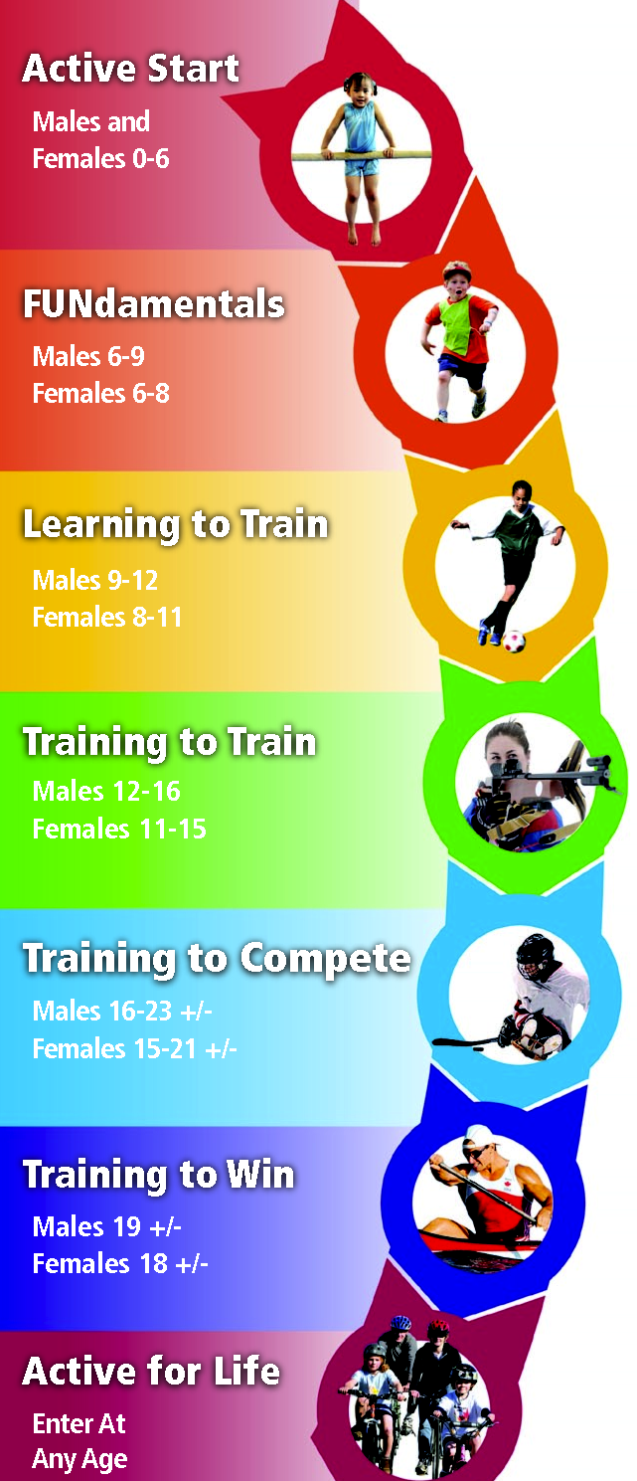
LTAD cont.
Active start
Children should be encouraged to play
FUNdamentals
Children should play games and sports that teach the fundamental movement patterns such as walking, running, catching, throwing, striking and swimming
Learning to train
During this stage, children should learn the movement patterns and physical attributes required to compete at a sport. They should also be introduced to structured training and coached in order to develop the mental capacity to further themselves.
Training to train
At this stage, an emphasis can be placed on intense training in order to fully develop the child’s physiological potential
Training to compete
Adolescents are now capable of competition and are training hard towards their goals
Training to win
The young athlete is now matured enough to win in their chosen sport

