Slide 1

Child and Adolescent Physiological Differences
Paul Bailey

Slide 2
Children are not ‘mini adults’
Children are not ‘mini adults’. They are a specific population group that must be treated differently, according to their specific needs. When dealing with any specific population group in an activity context, it is useful to differentiate using the following categories as a basis for the adaptations that you would make to an activity session:
Physiological differences of the specific population
Psychological differences of the specific population
Sociological differences of the specific population

Slide 3
Physiological differences
Every part of a child’s physiology is different to that of an adult and each child develops at their own rate. It therefore makes sense to consider:
All of a child’s physiological systems when designing activity programmes
  Skeletal
  Neuromuscular
  Cardio-respiratory / Energy system
The child’s ‘physiological age’ as opposed to ‘chronological age’
The child’s ‘training age’

Slide 4
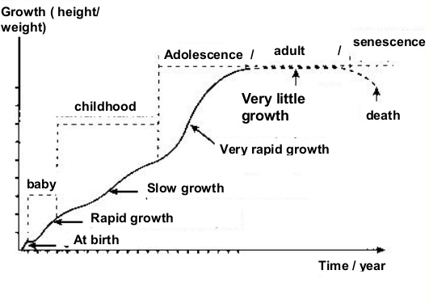
Skeletal system
Baby (Infancy)
Birth – approx 2 yrs
Early childhood
approx 3 – 8 yrs
Middle childhood
approx 9 – puberty
Adolescence
puberty – 18/21 yrs
Peak Height Velocity (PHV)
Approx 12 female / 14 male

Slide 5
Skeletal system and the benefits of exercise
Weight bearing exercise stimulates bone growth
Activity in childhood and early adulthood are essential for future bone health
A well developed exercise habit can help us when we are older to prevent osteoporosis

Slide 6
Skeletal system considerations
During childhood, bones are still growing, firstly in length and shape, secondly, in density. Bones grow from epiphyseal growth plates – In the arms, the humerus grows mostly at the proximal end and the radius and ulna at the distal end. In the legs, the femur grows at the distal end and the tibia at the proximal end
During late stages of puberty, the chest broadens in boys and the pelvis widens in girls
Girls develop a greater ‘carrying angle’ at the elbow and ‘q angle’ at the knee
Bone health is affected by our daily activities – we effectively ‘mould’ to our habitual positions
Weight bearing exercise stimulates our bone growth
Connective tissue, tendons and ligaments tend to have more elasticity than adults

Slide 7
Skeletal system consideration effects
Long bones (that are less dense) are also long levers. This can mean that forces placed through the skeletal can cause stress towards the ends of the bones, potentially resulting in injury to the vulnerable growth plate
As bones lengthen, the biomechanics of movement changes potentially leading to a difficulty in acquiring or keeping a skill
The carrying and q angles in a girls joints can cause a ‘valgus’ posture which can cause excessive wear on the joints
Allowing poor form to continue during an exercise over a long period of time could cause postural changes that will affect the child throughout their life
Excessive stimulation of bone growth due to repeated weight bearing movements (such as kicking a football) may cause excessive bone growth leading to pain in the area
Children could be prone to hyperextension

Slide 8
Skeletal system conditions
Growth plate fractures (Salter-Harris) – These can cause the osteoblast cells to either under or over ossify bone tissue. Growth of a limb should be monitored after any fracture
Chronic fracture – These can occur when bones are repetitively pushed together and can cause early fusing of bones
Osteochondritis (cartilage fragmentation) – Most likely to happen during PHV, this occurs when bone or cartilage breaks away during stressful movement. It generally affects knees, hips and spine
Back pain – Rapid growth, altered biomechanics and an inability to hold ‘neutral spine’ during a movement can cause non specific back pain

Slide 9
Skeletal system conditions
Sever’s disease – Most common during the growth spurt, this when the Achilles tendon repetitively pulls on the calcaneus bone in the heel, causing inflammation
Osgood-Schlatter disease – Again, most common during the growth spurt, this when the patella tendon repetitively pulls on the tibia causing calcification of the area (shown by an excessively large number at the top of the shin)

Slide 10
Skeletal system specific exercise adaptations
Avoid excessive training
Consider an appropriate sport for the child’s somatotype
Be aware of biomechanical differences and focus on movement pattern
Especially focus on ‘neutral spine’ for weight bearing exercises such as resistance training or rowing etc
Account for gender differences in size
‘Size matching’ of children
Consider physiological age – not just chronological
Limit high impact
Appropriate warm up (RAMP) and cool down
Use child-friendly equipment
Consider medical conditions

Slide 11
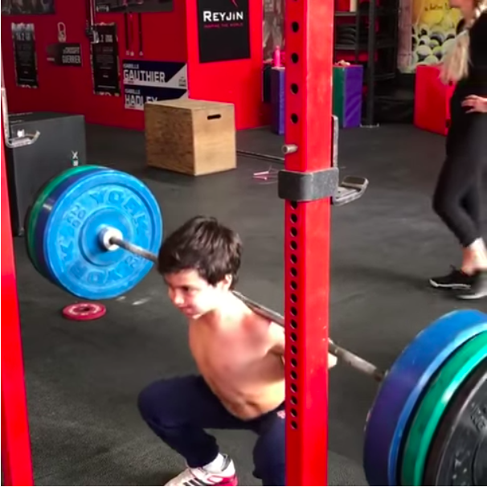
Skeletal system ability!

Slide 12
Neuromuscular system benefits of exercise
Training a child’s: strength, agility, balance, coordination, speed, running, jumping, throwing, catching, passing , kicking, striking with body, kinaesthesia (awareness of position and movement), gliding, buoyancy and striking with object are essential to maximise a child’s opportunity not only in sport, but at leading a full and active life with safe and sustainable movement

Slide 13
Neuromuscular system considerations
Muscle mass changes, especially during puberty
Only after puberty and the increased levels of primary sex hormones and Human Growth Hormone, will muscle mass increase significantly
Gross motor skills (those used for larger whole body movements as well as hand eye coordination etc) develop at different rates according to individual ‘talent’ and ‘training age’
Gross motor skill ability changes as the skeleton lengthens due to the change in biomechanics
Fine motor skills (ability to coordinate smaller muscles) develop at different rates according to individual ‘talent’ and ‘training age’
Optimal time for training skill is 8-11 yrs
Children are naturally more flexible than adults

Slide 14
Neuromuscular system consideration effects
Muscle mass changes mean that strength also changes. Relative strength to bodyweight will also change greatly in combination with increased lever length. Until puberty, and the increased anabolic hormone levels, there is no real need to train for strength or mass
Gross and fine motor skills can vary hugely from child to child, making some more and some less able to complete even basic movements safely and with good biomechanics
As the skeleton lengthens quickly during puberty (especially PHV) it is difficult for the neurological system to keep apace of the changes. Kinaethesia suffers and a child’s coordination and balance may be affected adversely
Children have the potential to be hypermobile due to their range of motion (ROM) and relatively unstable joints

Slide 15
Neuromuscular system specific exercise adaptations
Train movement pattern first
Train for speed of movement (less than 5 secs) in early childhood
Train for speed of movement (up to 20 secs) in middle childhood
Training for strength and size is of limited use until puberty
Incorporate as many movements as possible – especially during the ages 8-11
Do not specialise too early (unless it’s a demand of the sport!)
Training for strength can start to happen through adolescence – particularly from PHV onwards
Be aware of ROM during all movements
Consider medical conditions

Slide 16
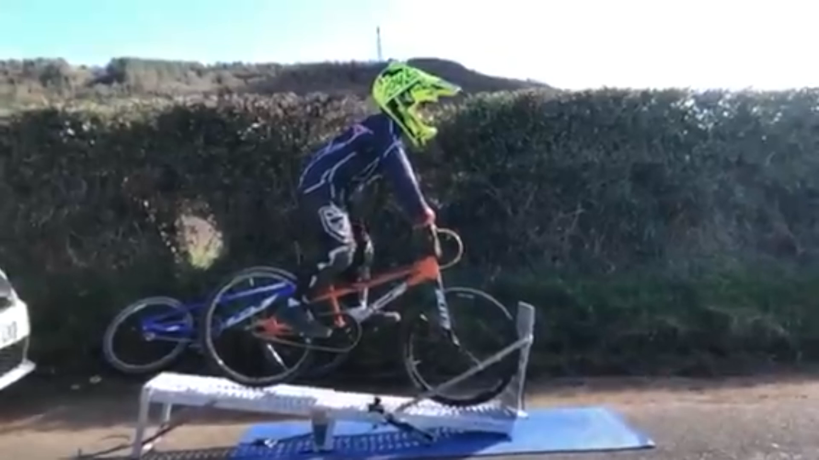
Neuromuscular system ability!

Slide 17
Cardio-respiratory/energy system benefits of exercise
Exercising during childhood will have many positive effects on the cardio-respiratory system’s development including:
Strengthening the heart muscle
Increasing stroke volume
Increasing lung efficiency
Exercise also has many health benefits including weight management

Slide 18
Cardio-respiratory/energy system considerations
Children have smaller hearts (total size and stroke volume), therefore lower cardiac outputs (or higher heart rates at any given exercise intensity)
Children have higher maximal heart rates than adults (around 215 bpm)
Blood pressure during childhood changes:
  Early childhood – 70/55
  Middle childhood – 110/62
  Adolescence – 115/65
  Adult – 120/80

Slide 19
Cardio-respiratory/energy system considerations
Children have smaller lungs and higher breathing rates at any given exercise intensity
Maximum ventilation increases with age:
  Age 5 – 40 litres @ 60 breaths per minute (panting)
  Adult - +110 litres @ 40 breaths per minute
Lung efficiency changes with age. This is shown by the total volume of air required to extract 1 litre of oxygen:
  Child – 38 litres of air per 1 litre oxygen
  18 year old – 28 litres of air per 1 litre of oxygen

Slide 20
Cardio-respiratory/energy system considerations
Raw VO₂max measurements rise from 6-18 yrs (b) and 6-14 yrs (g) (no increase in girls after the growth spurt)
Bodyweight normalised VO₂max stays the same throughout childhood (slight decline in post pubescent girls due to fat acquisition)
Due to small muscle mass, there is limited carbohydrate availability for anaerobic exercise
Children heat up and cool down faster than adults

Slide 21
Cardio-respiratory/energy system conditions
Cardiac risk – Every week in the UK, 12 young people die from undiagnosed cardiac conditions. Children engaged in exercise (especially intense or high volume CV) are particularly at risk and so should be screened from age 13 (www.c-r-y.org.uk)
Asthma – Asthma is an inflammatory disease affecting the bronchi and bronchioles that is common in children. It can make exhaling difficult, sometimes initiating an asthma attack. Asthma does not necessarily preclude children from exercise, however a coach should always screen for asthma prior to commencing a session and should check that those affected are carrying inhalers
Fatigue – Children’s body’s are under immense strain throughout their growth – and especially during the growth spurt. Intense or high volume exercise can cause children to fatigue quickly. Chronic fatigue can ultimately affect health and academic achievement. Children and their parents often place a high amount of pressure on themselves to perform like professional athletes and often need reminding that sport at a childhood/adolescent level is predominantly about FUN!

Slide 22
Cardio-respiratory/energy system consideration specific exercise adaptations
Warm ups can be shorter than for adults (5-10 mins)
Short interval training is advisable (less than 3 minute work periods)
Keep total anaerobic effort to less than 20 minutes
Don’t exercise to exhaustion
Regular water breaks to prevent dehydration
Keep rest periods active – especially if outdoors to prevent cooling
Consider medical conditions

Slide 23
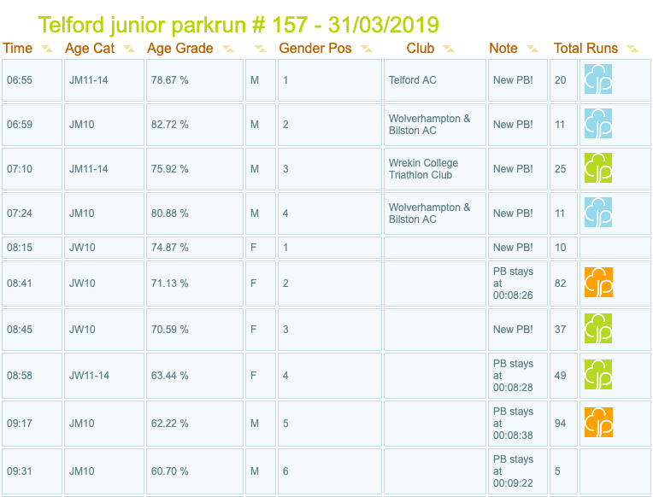
Cardio-respiratory/energy system ability!
17:30 5k pace!
20:30 5k pace!

Slide 24
Physiological and chronological age
Chronological age refers to how many weeks/months/years old a child is. Categorisation by chronological age is useful as particularly during growth stages that are slower, children tend to have similar abilities. Early childhood is when this method would be most valid
As children get older, their body’s have chance to develop at different rates. Therefore it becomes increasingly important to look at physiological development (age) – especially the difference between girls and boys through middle childhood and leading in to puberty. Considerations could include:
Height
Weight
Stature (broader, thinner)
Apparent muscle mass

Slide 25
Training age
‘Training age’ refers to a child’s exposure to activities and exercise – especially ‘structured practice’. A child who has received 2 years of coaching input aged 7, will likely have greater ability even than a child aged 9 with no coaching input. Therefore understanding a child’s activity history becomes important in order that differentiation can take place

Slide 26
Long-term ‘athlete’ development (Balyi & Way 2002)
FUNdamental – Age 6 to 8(g) / 9(b) (early childhood)
Decisions on training usually made on chronological age
Priorities would be:
  ‘Physical literacy’ including Agility, balance, coordination, speed, run, jump, throw, catching, passing , kicking, striking with body, kinaesthesia, gliding, buoyancy, striking with object
  Peak speed (quickness and agility less than 5 seconds in duration)
Learning to train – Age 8-11(g) / 9-12(b) (middle childhood)
Decisions increasingly made on physiological and training age
Priorities would be:
  Peak motor coordination
  Velocity skills

Slide 27
Long-term ‘athlete’ development (Balyi & Way 2002)
Training to train – Age 11-15(g) / 12-16(b) (Puberty/early adolescence)
Windows of optimal trainability (critical periods of accelerated adaptation)
Onset of PHV and related trainability
Priorities would be:
  Peak strength
  Velocity (up to 20 seconds)
  Aerobic velocity
Training to compete – Age 15-17(g) / 16-18(b) (late adolescence)
Training based on test and performance results
Training to win – Age 17+(g) / 18+(b) (adulthood)
Training based on test and performance results

Slide 28
Psychological development
Make an effort to get to know your children
Show the children you are interested in them
The child comes first – not the sport

