Slide 1
Level 3 Programming, adapting and delivering exercise for adults with long-term health conditions.
Consultation, screening and assessment

Slide 2
Session content
The importance of appropriate consultation, pre-activity screening and assessment when working with adults with long-term health conditions.
The information that should be obtained when consulting with and pre-screening adults with long-term health conditions before physical activity and exercise.
When to signpost or refer participants to other healthcare professionals prior to participation in exercise sessions.
Potential goals of adults with long-term health conditions and the importance of regular participation in physical activity and exercise to support these goals.
Appropriate consultation and communication skills to gather information from participants.
How to record and store information.

Slide 3

Consultation and health screening
Why is important to consult and screen clients with long-term health conditions?
What information would you need to gather?
How can essential information be gathered?
How is information used?

Slide 4
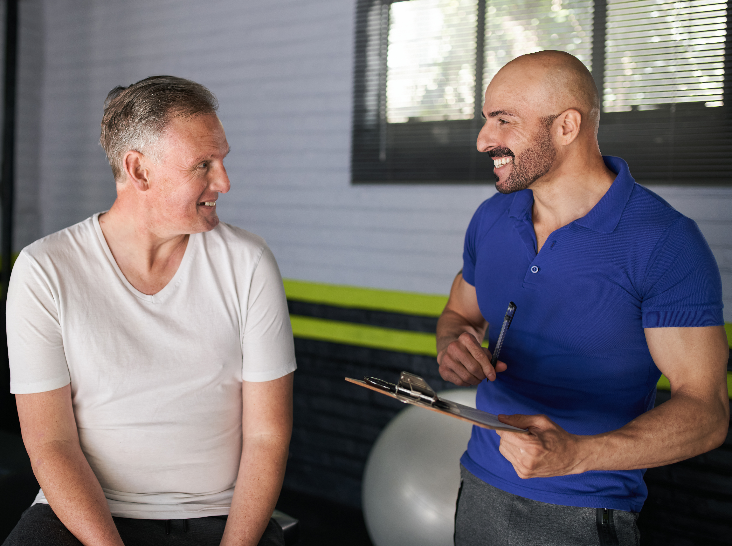
Consulting with clients
The initial consultation provides the opportunity to gather essential information from the client and make informed decisions about their readiness to exercise or any reasons for deferral and signposting.

Slide 5
The importance of health screening and consultation
Gather information to support decision making.
Are they ready to participate in exercise?
Are their needs within scope of practice?
Do you have the skills and knowledge to adapt to meet their needs?
Do they need to delay or defer exercise?
Do they need to be signposted to other professionals?
Are there any contraindications?
Do they need clinically supervised exercise?
Risk stratification and risk management

Slide 6
Essential information to gather
Age and sex.
Relevant health history.
Current health status.
  CVD risk factors.
  Medical conditions and medications.
  Past and present injuries.
  Lifestyle behaviours.
Impairments and disabilities.
Past and current activity levels or physical inactivity, including time spent on sedentary behaviours.
  Activity experience and preferences.
Reasons for attending – goals, aims.
Barriers and motivators etc.
  What does this information tell us?
  How can this information be used?

Slide 7
How can this information be gathered
Consultation
PAR-Q+
ePARmed-X+
Verbal screening checks
Transfer records – from health professionals
Health and functional assessments
Independent activity:
Complete the PAR-Q+ and ePARmed-x+ screening forms online (official website).
Discuss with peers.
Source: https://eparmedx.com/

Slide 8
Using information – assess risks of participation
Risks are higher for people who:
are sedentary and inactive.
are not sufficiently active (do not meet PA guidelines).
are deconditioned.
are unused to exercise.
have diagnosed health conditions, e.g. hypertension, angina etc.
have contraindications, e.g. unstable or uncontrolled conditions.
What are some of the risks of participation?

Slide 9

Using information – risks
Example risks include:
Strains and sprains
Hypoglycaemia
Cardiac incident
Fainting
Falls
Fractures
How likely are these risks?
How severe are the consequences?

Slide 10
Using information - CVD risk factors.
Risk factors | Criteria (if any information is not known, add one point) | Rating
Age | Men > 45 years, Woman > 55 years | +1
Family history | 1st degree relative - early cardiac event = male <55, female < 65 | +1
Cigarette smoking | Current cigarette smoker Those who quit within the previous 6 months Exposed to environmental tobacco smoke (secondhand smoke) | +1
Sedentary lifestyle | Not participating in 30 minutes of moderate intensity physical activity on at least 3 days/week for at least 3 months | +1
Obesity | BMI >30 Waist circumference: Male >102cm (40 inches) Waist circumference: female >88cm (35 inches) | +1
Cholesterol | LDL > 130mg/dl (3.37mmol/L) HDL <40mg/dl (1.03 mmol/L) Serum cholesterol >200mg/dl (5.18mmol/L) | +1
Diabetes | Fasting plasma glucose 100mg/dl (5.50mmol/l) - 126mg/dl (6.93mmol/l) Oral glucose tolerance test (OGTT) 140mg/dl(7.70mmol/l)– 200mg/dl (11mmol/l) | +1
Negative risk factor
High HDL | >60mg/dL (1.55mmol/L) | -1

Slide 11
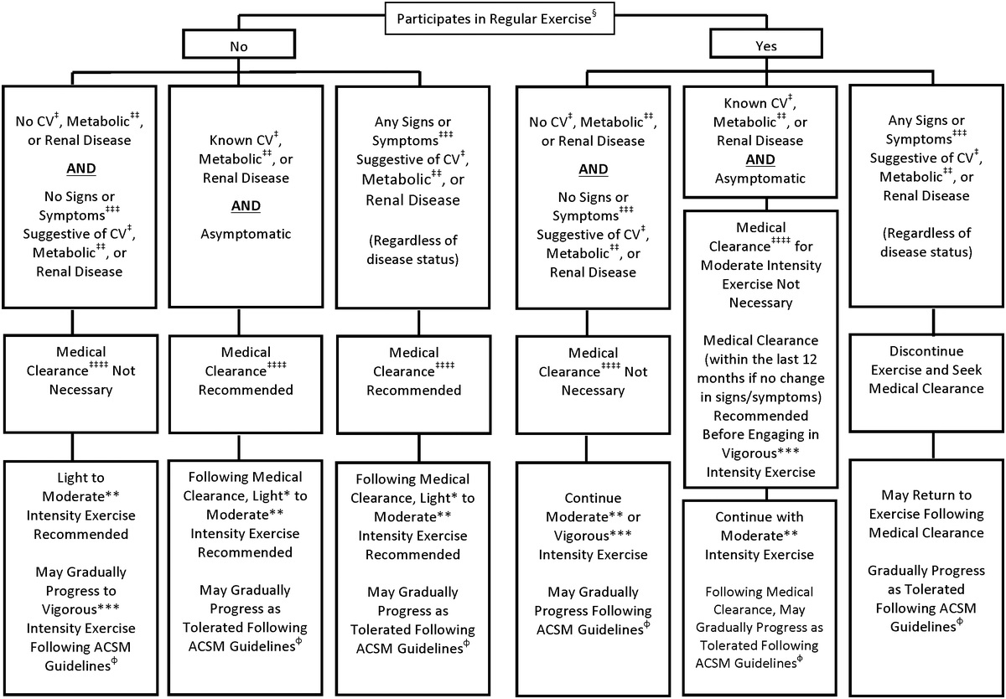
Using information - ACSM Algorithm (2022)

Slide 12
Using information - contraindications
Contraindications - risks outweigh benefits
Any unstable or uncontrolled condition
Resting blood pressure >180/100 mmHg
Resting heart rate above 120bpm (tachycardia)
Experience a negative change or increase in pain during exertion
Dizziness or excessive breathlessness during exertion
What other contraindications?
Further information:
ACSM Guidelines for exercise testing and prescription
British Heart Foundation National Centre (BHFC) ’Exercise referral toolkit’
ACSM Exercise management for persons with chronic diseases and disabilities

Slide 13
Using information - inclusion criteria – scope of practice
Condition | Inclusion criteria
Hypertension | Stable and controlled*.
Hypercholesterolaemia and hyperlipidaemia | Stable and controlled*.
Hypothyroidism and hyperthyroidism | Stable and controlled*.
Coronary heart disease (CHD) | Post-phase IV rehabilitation only! No new referrals. CVD risk factors in moderate category. No myocardial infarction (MI).
Peripheral vascular disease (PVD) | Without other complications.
Diabetes type 1 and 2 | Stable and controlled with no complications * Health care professional (HCP) to advise on modification of insulin prior to exercise (if insulin dependent).
Obesity | Body Mass Index (BMI) 30 - <40*.
Chronic obstructive pulmonary disease (COPD) | Mild/moderate only*.
Asthma | Stable and well controlled.
Osteoarthritis | Level 1 and 2 only.
Rheumatoid arthritis | Early stage and moderate only. Not in flare up.
Osteopenia and osteoporosis | Early stage and moderate. No fracture history. No falls risk.
Low back pain | Non-specific only. No red flags. Yellow (psychological) flags may require signposting to pain management.
Joint replacement | Post-rehabilitation/physiotherapy.
Depression | Less severe (mild to moderate only).
General anxiety disorder (GAD) | Less severe (mild to moderate).

Slide 14
Using information - informed decision making
Consider all available information:
Responses to screening questionnaires.
Information gathered during consultation:
  CVD risk factors
  Signs and symptoms or diagnosis of CVD, metabolic or renal failure
  Heath conditions
  Medications.

Slide 15
Using information - risk stratification and management
Eliminate the possibility of the risk happening
Reduce the likelihood of the risk happening
Isolate the potential of risk happening
Control the potential risk
Remember the risks of participation?
Consider – how would you eliminate, reduce, isolate, control?

Slide 16
Using information – Ready to participate
Tailor programmes or recommendations to meet individual client’s needs, wants and goals.
Maximise safety and effectiveness.
Eliminate or minimise risks.
Ensure appropriate exercise selection.
Find the best activity for the client’s needs.
Maximise enjoyment and commitment.
Promote long-term adherence.
Identify and overcome barriers to activity.
What are some example goals?

Slide 17
Manage health conditions.
Prevent further deterioration.
Maintain independence.
Improve health outcomes.
Social reasons.
Improve mental health.
Potential goals
What other goals?

Slide 18
Using information - Reasons for deferral or delay
Feeling unwell.
Forgotten medication e.g. asthma inhaler.
Medical clearance is required.
Inappropriate footwear or clothing.
Change in health condition, experiencing new symptoms.
Blood sugar levels exceed ranges.

Slide 19
Using information - Medical clearance
Medical clearance does not:
Remove the risks associated with exercise.
Mean that all types of exercise sessions will be appropriate.
Exercise professionals’ responsibility to assess:
The appropriateness of the type of exercise they deliver.
How (and if they can) tailor the type and intensity of the exercise to meet specific needs.
Whether a higher level of supervision is needed.
Whether the individual needs to be signposted to other professionals.

Slide 20
Using information - Reasons for signposting
Medical clearance.
  Signpost back to GP.
Conditions that exceed scope, e.g. stroke, cancer, cardiac conditions or frailty and falls risk.
  Signpost to instructor with appropriate qualification e.g. stroke rehabilitation.
Other health needs
  Signpost to other healthcare professionals, e.g. for smoking cessation, diet etc.
Contraindications.
  Exclusion.
Need clinically supervised exercise.
  Signpost back to GP for referral to appropriate services.

Slide 21

Consultation skills
What are essential consultation skills and considerations?

Slide 22
Considerations and skills
Appropriate consultation area with all paperwork available.
Sufficient time for information gathering – questionnaires, health or functional assessments.
Personal presentation and appearance are professional.
Effective communication skills:
  Listening
  Questioning
  Awareness of body language - own and clients
  Client centred - core conditions.

Slide 23
Consultation structure
Beginning:
Introductions, rapport building, and clarifying the purpose of the consultation.
Middle:
Information gathering and conducting and relevant assessments.
End:
Closing, agreeing a plan of action, and ensuring all paperwork is complete.

Slide 24
Working relationship
Make the client the most important person in the room (listen more than speaking).
  Empathy.
  Positive regard.
  Congruent without forcing own perception or expectations onto the person.
Listen actively without interrupting.
Hold hope and believe they can make improvements to support their wellbeing.
Encourage the client to make their own decisions to build autonomy and independence.
Lawrence and Bolitho (2011)

Slide 25
Person-centred working
Empathy
Empathy is the ability to imagine yourself as the other person, to experience the situation as they experience it, from their perspective and not from your perspective.
Positive regard
Positive regard is valuing the person, accepting they have the right to be themselves, not judging them and not making assumptions about them based on own biases (which are often irrational and subconscious)

Slide 26
Motivational interviewing skills
The four core skills used in MI are:
Open questions – how, when, what etc.
Affirming statements – positive statements.
Reflective listening – repeating what has been heard.
Summaries – summarising key points of conversation.
MI and behaviour change approaches will be covered further in later lessons.

Slide 27
Health assessments
These are important because they may present contraindications for participation in exercise and physical assessments:
Heart rate
Blood pressure
Body mass index (BMI) – height and weight measurement needed
Body composition – waist to hip ratio
How are these assessments conducted and/or how is information gathered?

Slide 28

Recording and storing information
What are essential records?
What legislation guides information recording and storage?

Slide 29
Consultation forms
Screening forms
Transfer records (where relevant)
Informed consent
Lesson plans and programming documents
Essential records
What other records?

Slide 30
Confidentiality and data protection
It is a legal and ethical requirement for all instructors to understand and abide by confidentiality and data protection laws.
Confidentiality means protecting personal information. This includes their personal details, medical history, lifestyle, family or any other information they may want to keep private.
Key legislation:
UK General Data Protection Regulations 2018
Data Protection Act 2018

Slide 31
Confidentiality and data protection
Maintain individual confidentiality.
Only collect essential information.
Obtain informed consent before collecting, sharing or transferring information.
Only share information if this is essential.
Only share information with relevant professionals.
Ensure all information is stored safely and securely.
Only keep records for the timeframes established by DPA.
When information is no longer needed – dispose of it safely.

Slide 32
Informed consent
Before sharing information
Reason for sharing information
Before assessment or exercise
Purpose of the exercise programme or assessments
Description of the exercise programme or assessments
Possible risks and benefits of participation
Responsibilities of both the client and instructor
Confidentiality and privacy statement
Statement to express participation is voluntary and their right to change their mind
Opportunity for client to ask questions (all questions/ responses to be recorded)
Client and instructor must sign and date
A legal record, and should be checked by legal professionals

Slide 33
Pair task
What are two main take away points from this lesson?
How will you apply these when programming and delivering for clients with long term health conditions?

Slide 34
Summary
The importance of appropriate consultation, pre-activity screening and assessment when working with adults with long-term health conditions.
The information that should be obtained when consulting with and pre-screening adults with long-term health conditions prior to physical activity and exercise.
When to signpost or refer participants to other healthcare professionals prior to participation in exercise sessions.
Potential goals of adults with long-term health conditions and the importance of regular participation in physical activity and exercise to support these goals.
Appropriate consultation and communication skills to gather information from participants.
How to record and store information.

Slide 35
Level 3 Programming, adapting and delivering exercise for adults with long-term health conditions.
Consultation, screening and assessment

